Slide 1



Notes:
Share the history of Bounce Back Project (see BBP beginnings in training manual) – started in 2015 following the loss of 2 physicians in Wright County, MN

Slide 2

What is Bounce Back project?
Unique collaborative of physicians, nurses, healthcare leaders and community members
Single purpose – to impact the lives of individuals, communities, and organizations by promoting health through happiness
Notes:
What?

Slide 3
Bounce Back Project Tools
Purpose: to expand resilience by retraining our mind to focus on the positive, increase the feelings of well-being and decrease the feelings of depression
  Random Acts of Kindness
  Three Good Things
  Gratitude
  Social Connections
  Mindfulness and Self-Care
  Purpose
Notes:
Why and How?

Slide 4
Gratitude
Notes:
Gratitude can be a powerful tool for our well-being! Living a life of gratitude can increase your resilience and lead to a happier, healthier life. And it doesn’t cost a thing.

Slide 5
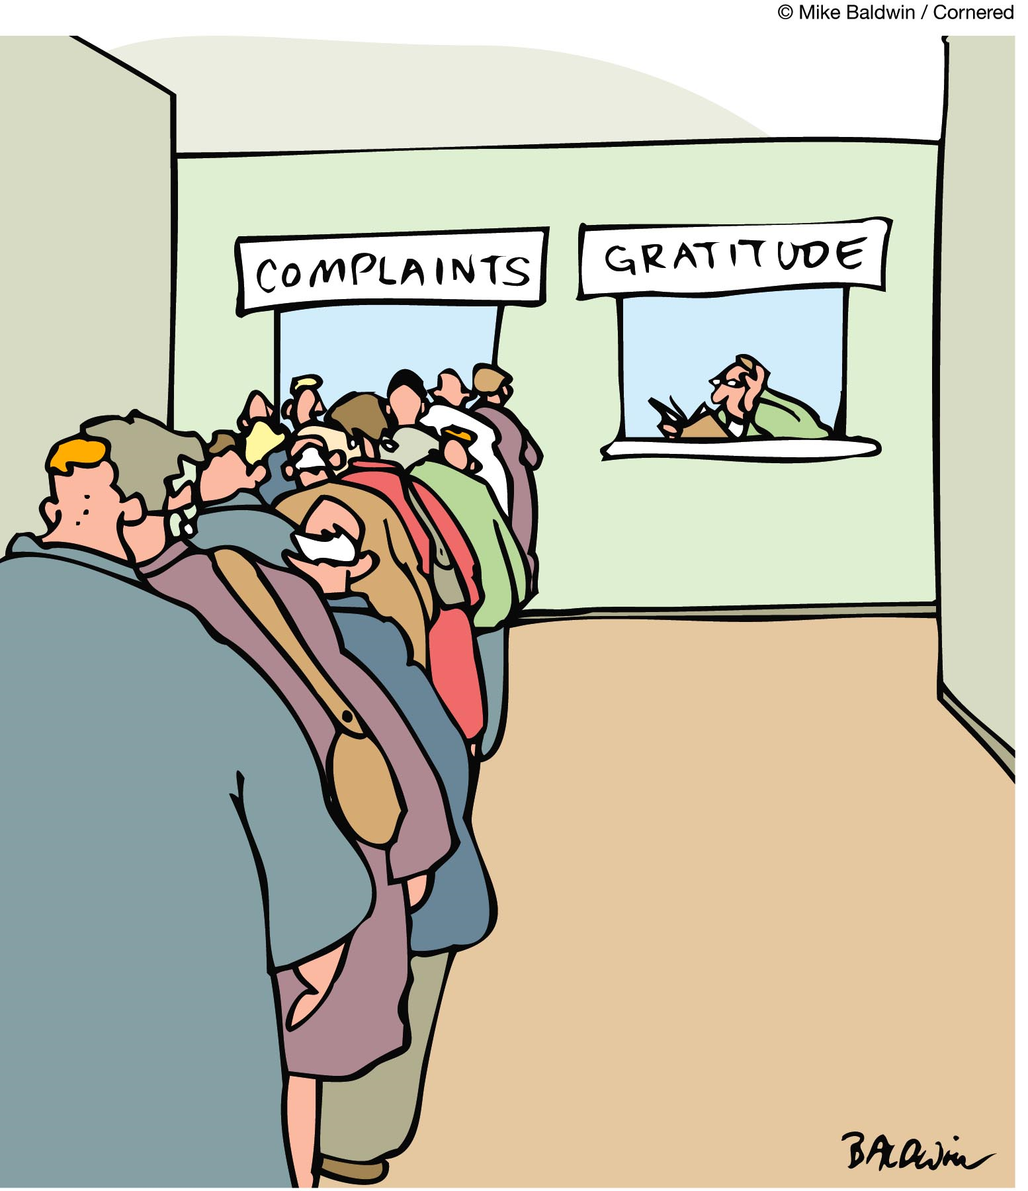
Which Line are you most often standing in?
Notes:
We know that the complaint line exists, right? We see and hear about it everywhere – in retail stores, restaurants, health care settings, among other places. We are all very quick to complain when things do not go as planned or go our way, but why are we not as quick to share gratitude when it is earned? Wouldn’t it be great to shift this line to the right? We need to model gratitude and help our younger generations learn this important life skill!

Slide 6
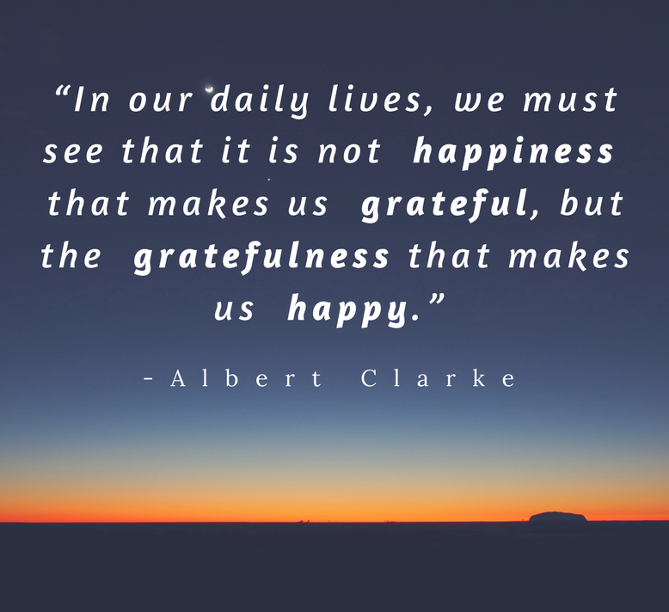
Being Grateful Makes Us Happy
Notes:
It is definitely the things in life that we are grateful for that bring us the happiness that we seek. This can be a bit of a shift in our thinking…what are you grateful for?

Slide 7
Gratitude Is Your Gift To Yourself
Decreased depressive symptoms and increased feelings of well being ^{5,1}
Improved psychological well-being ⁶
Improved working memory ²
Improved sleep ³
Improved immune system function ⁴
Improved relationships ⁵
Improved coping with emotional upheavals ⁶
Notes:
There are so many great health benefits from living a life of gratitude!
1. Seligman ME, Steen TA, Park N, Peterson C. Positive psychology progress: empirical validation of interventions. Am Psychol 2005;60:410-21.
2. Klein K, Boals A. Expressive writing can increase working memory capacity. J Exp Psychol Gen 2001;130:520-33.
3. de Moor C, Sterner J, Hall M, et al. A pilot study of the effects of expressive writing on psychological and behavioral adjustment in patients enrolled in a Phase II trial of vaccine therapy for metastatic renal cell carcinoma. Health Psychol 2002;21:615-9.
4. Petrie KJ, Booth RJ, Pennebaker JW. The immunological effects of thought suppression. J Pers Soc Psychol 1998;75:1264-72.
5. Slatcher RB, Pennebaker JW. How do I love thee? Let me count the words: the social effects of expressive writing. Psychol Sci 2006;17:660-4.
6. Barclay LJ, Skarlicki DP. Healing the wounds of organizational injustice: examining the benefits of expressive writing. The Journal of applied psychology 2009;94:511-23.

Slide 8
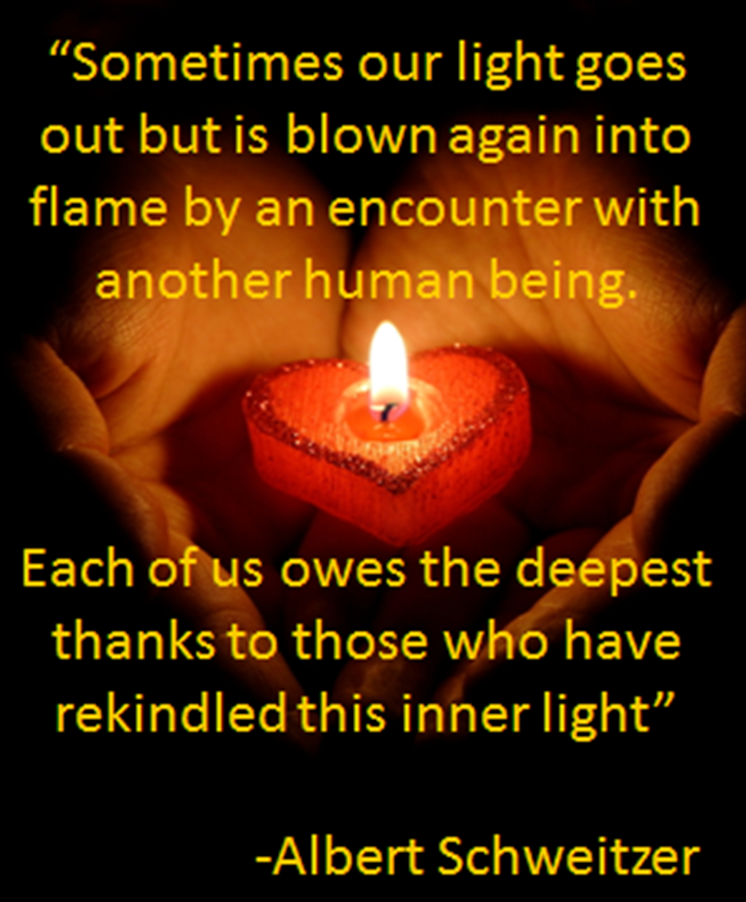
Gratitude
Please close your eyes and think about someone who, at some time in your lives, has rekindled your inner light. Someone who you are truly grateful for and have never properly thanked.
Notes:
No matter how old you are, there have been people in your life that have helped and guided you to where you are today. Perhaps a teacher, a coach, coworker, mentor, friend, or family member who has been supportive to you and helped you during tough times or when you needed assistance with something. Often we have not taken the time to properly thank those people for making a difference in our lives. Bounce Back Project encourages you to write a letter of gratitude to this person and share with them how important they have been to you.

Slide 9
Gratitude Experiment
Science of Being Happy
Notes:
Let’s watch a video on how important sharing gratitude letters can be.

Slide 10
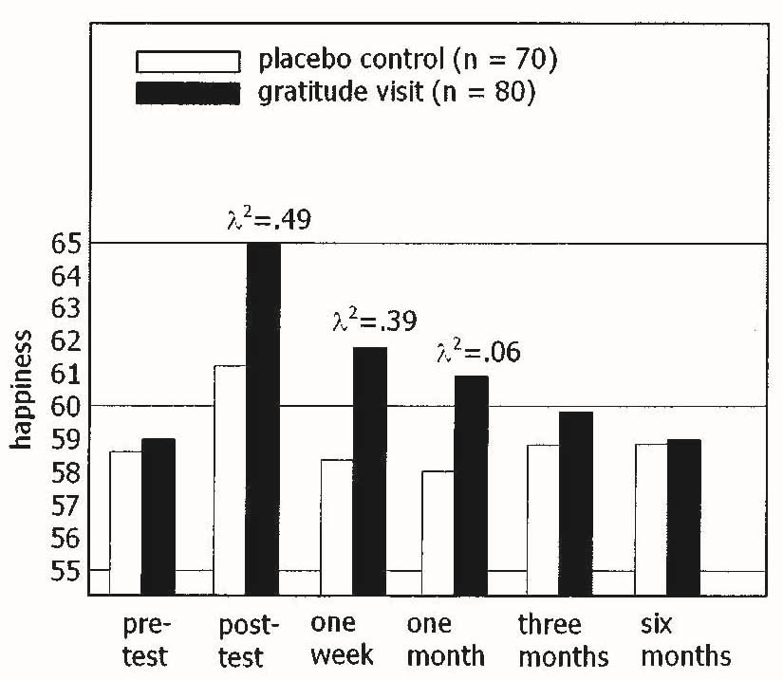
Gratitude Letter Effectiveness
Seligman, Steen, Park & Petersen, 2005
Notes:
Prior to sharing their Letter of Gratitude, happiness was fairly low. However, after sharing their gratitude with someone who has made a difference in their life, their happiness increases and stays up for several months. In fact, writing a short letter of gratitude (just 250 words or so) can increase your happiness for up to 6 months!

Slide 11
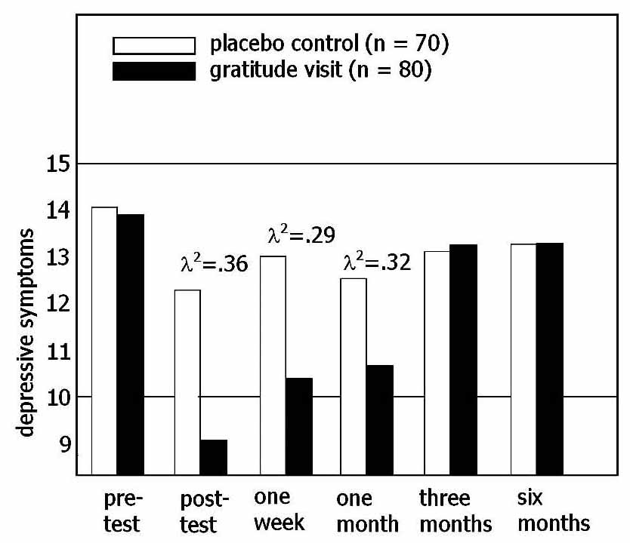
Gratitude Letter Effectiveness
Seligman, Steen, Park & Petersen, 2005
Notes:
Depression levels are fairly high prior to sharing the letter of gratitude, but after go way down for about 3 months. So what can you do in 3-6 months? Write another letter! We all have several people in our lives that we can thanks!

Slide 12
Gratitude
You now have the opportunity to write that person you thought about a thank you note … right now!
Notes:
Pass out thank you notes and have people write their notes. Give them 5-10 minutes if time allows.

Slide 13
Gratitude?
Gratitude starts where our entitlement ends.
Notes:
I think most of us as adults really appreciate those things that we worked really hard for. When we have put in the time and energy to make something happen, we tend to appreciate it more. This slide is really a good reminder to not feel entitled to things, but to feel gratitude when we have earned the right to do so. This is something we can work on and model for our younger generations.

Slide 14
Lollipop Moments
Can I ever do anything worth someone else’s gratitude?
Do I make a difference?
We wonder just like many other people do – express your gratitude to someone TODAY and you will change the world
Be The Leader In Gratitude
Notes:
We never know how we may affect someone else as we go through our daily lives. Chances are that someone is grateful for you and the things you do for them!
Watch this video (must be connected to wi-fi to watch)

Slide 15
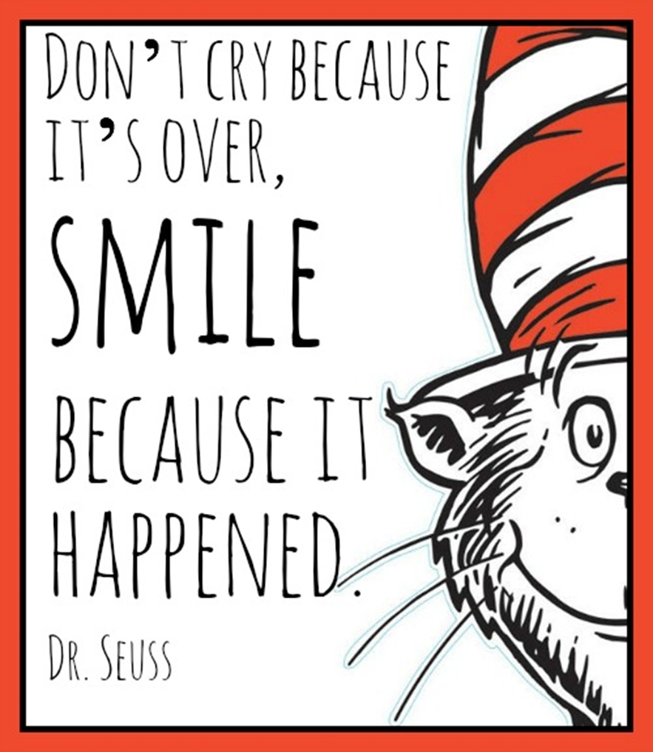
Notes:
Gratitude…every single day!

Slide 16
Want to Become Part of the Movement?
Text bounceback to: 833-956-0928
Like us on Facebook:
Bounce Back Project
Check out our web pages: www.bouncebackproject.org
Sign up for newsletter: https://bit.ly/3wVS3zo

