Slide 1



Notes:
Share the history of Bounce Back Project (see BBP Beginnings in training manual) – started in 2015 in Wright County, MN after the loss of 2 local physicians…

Slide 2


What is Bounce Back Project?
Unique collaborative of physicians, nurses, healthcare leaders and community members
Single purpose – to impact the lives of individuals, communities, and organizations by promoting health through happiness
Notes:
What?

Slide 3
Bounce Back
Project Tools
Purpose: to expand resilience by retraining our mind to focus on the positive, increase the feelings of well-being and decrease the feelings of depression
Random Acts of Kindness
Three Good Things
Gratitude
Social Connections
Mindfulness and Self-Care
Purpose
Notes:
Why and How?

Slide 4

Social Connections
Notes:
We are going to be digging in a little deeper to the relationship pillar of resilience and find out why social connections are so important for our overall well-being.

Slide 5
A Quick Exercise
Write down the things you think you need to get, do, or accomplish to be happy
Notes:
Do this activity with the teens if your time allows…

Slide 6
A Quick Exercise
Write down the things that make you happy now without doing more, getting more, or accomplishing more

Slide 7
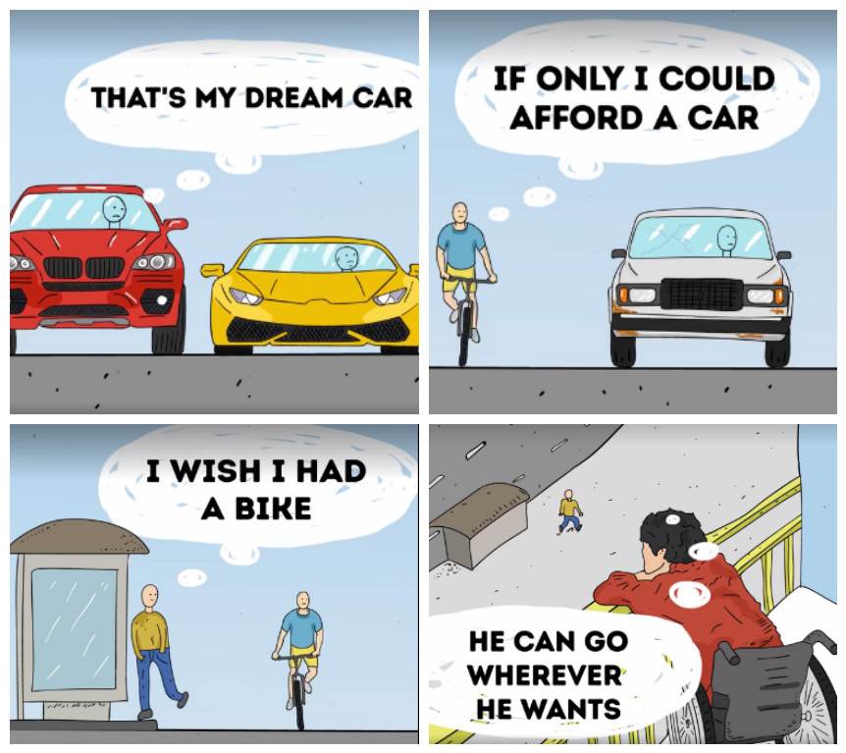
Chasing Happiness
Notes:
If you ask anyone what they want more than anything for themselves or for their kids, they will likely say happiness. This cartoon is indicative of what our society thinks of happiness. The more things we have the happier we are. We always want more. Happiness is correlated with money up to a point of 75K dollars a year. This buys us a roof over our head, food in our belly, a car that doesn’t break down. Anything more than 75K is not correlated with happiness. Another study has shown that happiness is correlated with money but if it is to purchase experiences not things. And specifically if the experiences are with other people you have relationships with.

Slide 8
Chasing Happiness
We all want it, right? How do we get it?
  Being Grateful
  Being Content
  Having Quality Relationships
Stop saying “I will be happy when…”
and start saying “I am happy now because…”
Notes:
We all seem to chase happiness throughout our lives. But did you know that the keys to long lasting happiness, health and longevity come from these 3 components? And none of them cost a thing! Start living in the present instead of chasing the “happiness hurdle” through life!
Stop Chasing Happiness, Look for Meaning Instead | Psychology Today

Slide 9

How to be happy

Slide 10

The Good Life…
Notes:
Because of these things, BB has started to promote the power of social connections. In the next video you will see Robert Waldinger, the head of a 75-year long study from Harvard talking about the importance of relationships in our life.

Slide 11
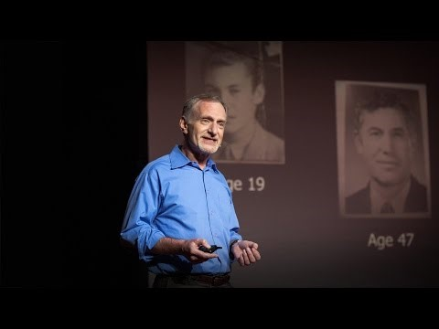
Harvard Study of Adult Development
Notes:
Good Relationship (short version)
https://www.ted.com/talks/robert_waldinger_what_makes_a_good_life_lessons_from_the_longest_study_on_happiness?utm_source=tedcomshare&utm_medium=email&utm_campaign=tedspread
The best predictor of your overall health, happiness and longevity is how good your relationships are.
The Harvard Study of Adult Development may be the longest study of adult life that's ever been done. For 75 years, we've tracked the lives of 724 men, year after year, asking about their work, their home lives, their health, and of course asking all along the way without knowing how their life stories were going to turn out. The clearest message that we get from this 75-year study is this: Good relationships keep us happier and healthier. Period.

Slide 12
Loneliness Is Bad For Our Health
Living with loneliness increases your odds of dying early by 45% (more than obesity – 20%)
Causes the same amount of damage to your lifespan as smoking 15 cigarettes a day
Loneliness is associated with a higher risk of high blood pressure in older people
Makes it harder to recover from illnesses, including mental health concerns
Notes:
http://mnmentalhealth.org/files/3815/5836/8706/4MIND4BODY_-_SOCIAL_CONNECTIONS_AND_RECREATION_0.pdf
Social isolation and its effect on physical health - https://www.hcinnovationgroup.com/policy-value-based-care/public-health/article/21085786/at-the-ahip-2019-conference-former-surgeon-general-murthy-speaks-of-social-isolation-and-its-impact
SOURCES
1 2018 Cigna U.S. Loneliness Index. Retrieved from https://www.cigna.com/assets/docs/newsroom/loneliness-survey-2018-full-report.pdf. 2 Hawkley LC, Thisted RA, Masi CM & Cacioppo JT. (2010). Loneliness predicts increased blood pressure: 5-year cross-lagged analyses in middle-aged and older adults. Psychology and Aging. 25(1):132-141.
3 Ozbay, F., Johnson, D. C., Dimoulas, E., Morgan III, C. A., Charney, D., & Southwick, S. (2007). Social support and resilience to stress: from neurobiology to clinical practice. Psychiatry (Edgmont). 4(5):35.
4 Hughes, Spencer, et al. (2014). Social support predicts inflammation, pain, and depressive symptoms: longitudinal relationships among breast cancer survivors. Psychoneuroendocrinology. 42:38-44.
5 Holt-Lunstad J, Smith TB, Layton JB (2010) Social Relationships and Mortality Risk: A Meta-analytic Review. PLoS Med 7(7): e1000316.
6 Korpela K, Tyrväinen L. (2014). Analyzing the mediators between nature-based outdoor recreation and emotional well-being. Journal of Environmental Psychology. 37: 1-7.
7 Chen, C.-C., & Petrick, J. F. (2013). Health and Wellness Benefits of Travel Experiences: A Literature Review. Journal of Travel Research.
52(6):709–719.
8 Babiss, LA & Gangwisch JE. (2009). Sports Participation as a Protective Factor Against Depression and Suicidal Ideation in Adolescents as Mediated by Self-Esteem and Social Support. Journal of Developmental & Behavioral Pediatrics. 30(5):376-384.
9 Verghese J, Lipton RB, et al. (2003). Leisure Activities and the Risk of Dementia in the Elderly. The New England Journal of Medicine.
348:2508-2516.
10 Wilson JF & Christensen KM. (2012). The Relationship Between Outdoor Recreation and Depression Among Individuals With Disabilities. Journal of Leisure Research. 44(4):486-506.
11 Soylu, C., Ozaslan, E., Karaca, H., & Ozkan, M. (2016). Psychological distress and loneliness in caregiver of advanced oncological inpatients. Journal of Health Psychology. 21(9):1896–1906.
12 Kosloski, K., & V., R. J. (1993). The Effects of Respite on Caregivers of Alzheimer’s Patients: One-Year Evaluation of the Michigan Model Respit Programs. Journal of Applied Gerontology. 12(1)4-17.

Slide 13
Humans Are Wired For
True Social Connection
People with strong social relationships are 50% more likely to live longer
40% of Americans are lonely at any one time
4am friends – do you have any?
Why is talking about loneliness taboo
Social media makes feeling of loneliness worse
Comparison WILL kill your joy
Notes:
. In one of the studies the journal published, University of Chicago psychologist John Cacioppo and his colleagues hypothesized that the feeling of loneliness may have had adaptive value — both for humans and for other animals — because it prompted a realization that one has strayed from the social community. Like hunger and pain, loneliness may be part of a biological “warning system” to enhance our chances of survival and reproduction. The study suggests that loneliness provides a motivation to reconnect with others who may help to protect us from predators or provide other survival benefits.
The first is that social connections are really good for us, and that loneliness kills. It turns out that people who are more socially connected to family, to friends, to community, are happier, they're physically healthier, and they live longer than people who are less well connected. And the experience of loneliness turns out to be toxic. People who are more isolated than they want to be from others find that they are less happy, their health declines earlier in midlife, their brain functioning declines sooner and they live shorter lives than people who are not lonely.
Social media is really antisocial media. How many Facebook, Snapchat, or Instagram friends do you have? When was the last time you connected with someone face to face. How many times have you sent that text or email and someone misunderstood it. A lot of our communication is via facial feedback. How many times have you walked into a restaurant to see 4 people on phones all looking down at them and not talking to each other. Average person spends 4 years of their life looking down at their cellphone. The internet paradox – the more people use social media the worse they felt. The more online friends you have the lonelier you are…Face to face interaction is important

Slide 14
Healing Power Of
Social Connections
Extended life
Decrease feelings of anxiety and depression
Better perception of own well-being
Increase in self-esteem and social support
Decrease in suicidal ideation
Strengthens your immune system
Notes:
http://mnmentalhealth.org/files/3815/5836/8706/4MIND4BODY_-_SOCIAL_CONNECTIONS_AND_RECREATION_0.pdf
http://ccare.stanford.edu/uncategorized/connectedness-health-the-science-of-social-connection-infographic/
In a 2010 article in the Journal of Health and Social Behavior, key research themes between relationships and health and its implications for policy were reviewed. The authors summarized the detriments of isolation and five main findings on social relationships from various studies. They stated:
Captors use social isolation to torture prisoners of war—to drastic effect.
Social isolation of otherwise healthy, well-functioning individuals eventually results in psychological and physical disintegration, and even death.
Over the past few decades, social scientists have gone beyond evidence of extreme social deprivation to demonstrate a clear link between social relationships and health in the general population.
Adults who are more socially connected are healthier and live longer than their more isolated peers. This article describes major findings in the study of social relationships and health, and how that knowledge might be translated into policy that promotes population health.
Key research findings include:
(1) social relationships have significant effects on health;
(2) social relationships affect health through behavioral, psychosocial, and physiological pathways;
(3) relationships have costs and benefits for health;
(4) relationships shape health outcomes throughout the life course and have a cumulative impact on health over time; and
(5) the costs and benefits of social relationships are not distributed equally in the population.

Slide 15
Create Social Connections
So…why are we so lonely?
Why are we so unhappy?
And what is the secret to happiness and building meaningful relationships?

Slide 16
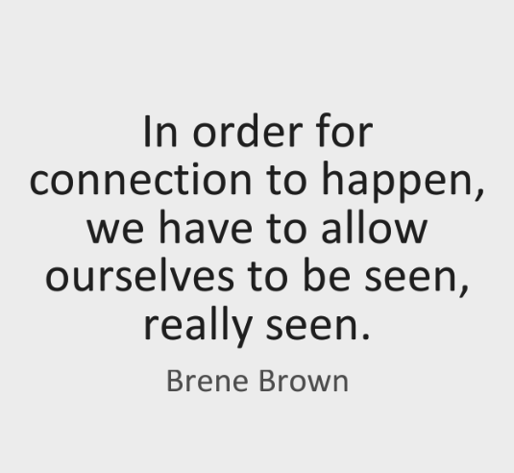
The Courage To Be Happy

Slide 17

Have The
Courage To
Show Up And
Be Seen!
Notes:
Our relationships are important and it is important for us to be our true self, take off the masks of who we think we need to be and be who we really are.

Slide 18
What Can You Do For Yourself?
Take a long, hard look at your perceived connections
Build your relationships by being authentically who you are, not who you want to be
Reach out to one person you care about every day
Do things in nature
Participate in rec sports
Take a vacation
Organize leisure activities with people you know
Take a class
Volunteer

Slide 19
Want to Become Part of the Movement?
Text bounceback to: 833-956-0928
Like us on Facebook:
Bounce Back Project
Check out our web pages: www.bouncebackproject.org
Sign up for newsletter: https://bit.ly/3wVS3zo

