Slide 1



Notes:
Share Bonce Back Project history (see BBP beginnings in training manual) – started in 2015 in Wright County Mn after the loss of 2 local physicians

Slide 2

What is Bounce Back
Project?
Unique collaborative of physicians, nurses, healthcare leaders and community members
Single purpose – to impact the lives of individuals, communities, and organizations by promoting health through happiness
Notes:
What?

Slide 3
Bounce Back
Project Tools
Purpose: to expand resilience by retraining our mind to focus on the positive, increase the feelings of well-being and decrease the feelings of depression
Random Acts of Kindness
Three Good Things
Gratitude
Social Connections
Mindfulness and Self-Care
Purpose
Notes:
Why and How?

Slide 4

Mindfulness & Self-Care
Notes:
Mindfulness & Self-Care – two of the 5 pillars of resilience and very important components of our overall well-being

Slide 5
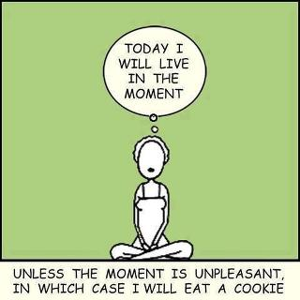
Notes:
I think that this is how most of us feel on most days, right? I want to tell you a little more about mindfulness and self-care and why they are so important for your health and happiness.

Slide 6
Mindfulness:
A state of active, open attention on the present.
When you’re mindful, you observe your thoughts and feelings from a distance, without judging them good or bad.
Instead of letting your life pass you by, mindfulness means living in the moment and awakening to experience.
Notes:
Mindfulness involves acceptance, there is no “right” or “wrong” way to think or feel in a given moment
Tune into what you are sensing in the present moment rather than rehashing the past or imagining the future

Slide 7
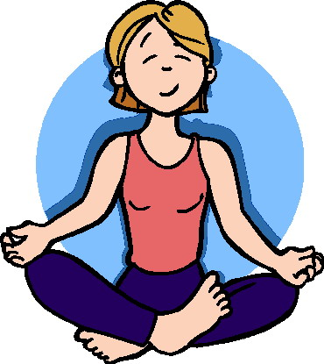
In other words…
Focusing on one thing at a time
Being aware of your emotions and acknowledging that they won’t last forever.
Staying present, in this moment.
  Or as we like to say: “Be here now”
Notes:
Recognize that your thoughts and feelings are fleeting and do not define you…this insight can free you from negative thought patterns

Slide 8
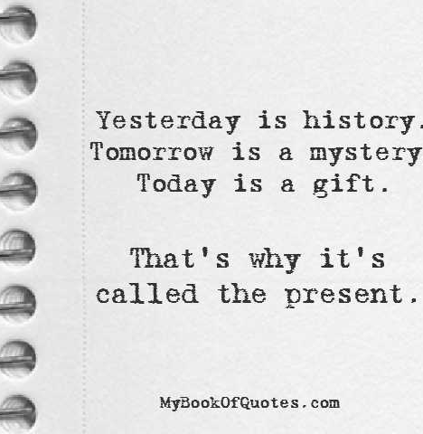
Mindfulness
Notes:
(Read this out loud slowly)

Slide 9

Why Practice Mindfulness?
Practicing mindfulness for even a few weeks can bring a variety of physical, psychological, and social benefits:
Boosts our immune system
Increases positive emotions and reduces negative emotions and stress
Increases gray matter in regions of our brain linked to learning, memory, emotion regulation, and empathy
Helps us focus; tune out distractions, improves memory and attention skills
Fosters compassion for others and ourselves
Helps parents, schools, prisons, healthcare professionals, veterans and more
Enhances relationships
Fights Obesity
Notes:
Boosts our immune system and the ability to fight off illness
Fosters compassion and altruism; makes us more likely to help someone in need and increases activity in neural networks involved in understanding the suffering of others and regulating emotions. Evidence suggests it might boost self-compassion as well.
Enhances relationships; makes couples more satisfied with their relationship, makes each partner feel more optimistic and relaxed, and makes them feel more accepting of and closer to one another.
Parents: parents who practice mindfulness report being happier with their parenting skills and their relationship with their kids, and their kids were found to have better social skills
Schools; mindfulness in the classroom reduces behavior problems and aggression among students, and improves their happiness levels and ability to pay attention. Teachers practicing mindfulness show greater compassion and empathy.
Healthcare; mindfulness helps HC professionals cope with stress, connect with their patients, and improve their general quality of life. It also helps mental health professionals by reducing negative emotions and anxiety, and increasing their positive emotions and feelings of self-compassion
Prisons; mindfulness reduces anger, hostility, and mood disturbances among prisoners by increasing their awareness of their thoughts and emotions, helping with their rehabilitation and reintegration
Veterans; It can reduce the symptoms of PTSD in the aftermath of war
Obesity; practicing “mindful eating” encourages healthier eating habits, helps people lose weight, and helps them savor the food they do eat
*Greater Good “What is Mindfulness” – greatergood.berkeley.edu

Slide 10

Mindfulness → Happiness
People who practice mindfulness show higher levels of overall happiness

Slide 11
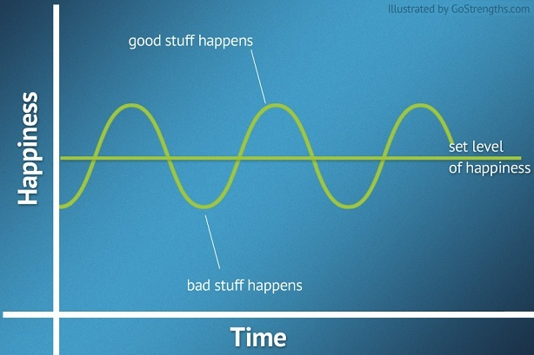
People who practice mindfulness can raise their set level of happiness.
Notes:
Your Happiness Set Point comes from 3 different places:
50% Genetics – inherited from your parents
10% Life Circumstances – rich or poor, beautiful or average, employed or unemployed, nice car or regular car, etc. (look into your own life and think how much time and energy we spend on trying to change this category)
40% Thoughts, actions, values – we all need to work to gain more knowledge on these matters. By changing our thoughts, actions and values (our intentional activities and choices that we make) that is where we can find ways to increase our happiness.
http://thoughtmedicine.com/2010/05/7-simple-ways-to-raise-your-happiness-set-point/

Slide 12
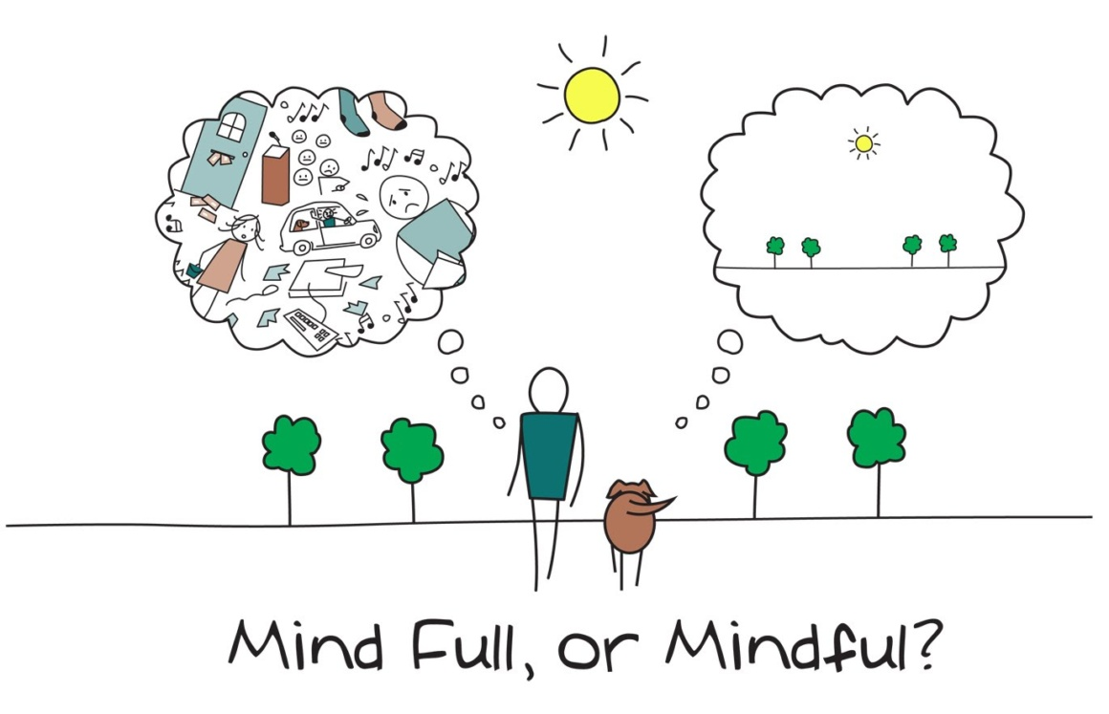




Notes:
So I ask….are you Mind Full or Mindful? I think that most of us fall somewhere in between, but can we work to get better at being mindful?

Slide 13
Studies show…
What makes people happy has less to do with what they are doing, and more to do with whether their attention is fully present in the moment.
Notes:
Matt Killingsworth did a study with 15,000 individuals. It was a diverse sampling of people across 80 countries. At random times throughout the day, people were contacted through their phones and asked to rate their current level of happiness, what activity they were doing when the call came, and whether or not their mind was wandering from the activity. People who focused on their present moment experience were significantly happier than people whose mind wandered away from the moment. According to Killingsworth, the average persons mind is wandering around 47% of our day – and when the mind wanders we don’t feel happy. Spending so much time with the mind wandering makes us vulnerable to depression, stress, anxiety and other negative emotions.
It turns out, happiness is not found in external things at all, but is a power we hold within ourselves.

Slide 14

Notes:
Maybe this should be our street sign, right? Something to remind us every day to live in the present and not be distracted by things we cannot control.

Slide 15

Mindfulness can even help us
rewire our brains
to be happier.

Slide 16
Here’s how thoughts work:
The storyteller thoughts:
These thoughts are a little melodramatic and blows things way out of proportion.
Go to the negative/jumps to the conclusion.
The storyteller thoughts tend to take things personally, or “this must be about me!”
The observer thoughts:
Observes how the world reacts to us without any bias.
Realistically reflects on the situation as it is, no more, no less. Just observes the moment.
Asks for more clarification, no conclusions before getting the whole story.
Notes:
There are 2 sides to our brains. One side which is the storyteller and the other which is more of an observer.
https://www.health.harvard.edu/blog/right-brainleft-brain-right-2017082512222
https://www.apa.org/monitor/2013/11/right-brained
https://www.psychologytoday.com/us/blog/the-athletes-way/201712/left-brain-right-brain-study-debunks-decades-old-neuromyth
https://www.ncbi.nlm.nih.gov/pmc/articles/PMC3897366/
https://medicalxpress.com/news/2018-06-left-center-emotion-brain.html

Slide 17
Our thoughts play out like this:
Observer: “The boss seems agitated. I’ll check in later.”
Storyteller: “Better get the resume together. We’re getting fired.”
The boss slams the door.

Slide 18
Or like this:
A friend looks at you funny:
Observer: ‘I wonder what happened, I’ll ask if he or she wants to talk.’
Storyteller: ‘He or she hates me, we’re no longer friends!’
Notes:
Depending on which side of your brain you are using or which is most dominant, your reaction may differ. I think we all know a person who tends to jump to conclusions each and every time without looking at all the information.

Slide 19
The good news is, these thoughts are only one part of you
You can reflect on whether these thoughts are serving you in living your best life.
This is where mindfulness(awareness) comes in.
Mindfulness is about focusing on the concrete information we have, not getting wrapped up in interpretations.

Slide 20
Resilience Through Awareness
We all have an innate ability to learn how to manage stress and become more resilient by being aware of our thoughts and reflecting on those thoughts.
Are these thoughts realistic/true/creditable/accurate/rational/sensible?
Both yes and no are correct
By reflection we can better take care of self through self-compassion and asking ourselves what we need right now, in this moment.

Slide 21





Ultimately, you’re in charge.
Notes:
Don’t forget, YOU get to decide how you want to think and act.

Slide 22
What you can do is …
Listen to your thoughts as you go about your day and contradict dramatic assumptions.
Look for other ways a situation can be interpreted. Is this truly about you?
The more you practice, the more often your brain is using these “positive pathways” to solve a problem.
Eventually, this becomes a habit and storytelling starts to rewire in a more positive, mindful way.

Slide 23
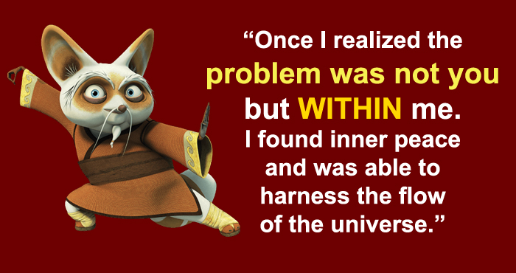

Slide 24

Why Mindfulness is a Superpower
Notes:
Great short video (Must be connected to wi-fi)

Slide 25
How do we begin to cultivate being mindful?
Being non-judging
Developing patience
Fostering a beginner’s mind that is open to life’s experiences
Extending trust
Becoming non-striving
Demonstrating acceptance
Letting go; allowing yourself to not become attached
Notes:
Being non-judging
Becoming more aware of the habit of categorizing people and events as good, bad, or indifferent and avoiding these labels.
Developing patience
Gaining the wisdom to know and accept the fact that some things must unfold in their own time.
Fostering a beginner’s mind that is open to life’s experiences
Seeing things as if they were happening for the first time; allowing ourselves to be receptive to all possibilities.
Extending trust
Trusting in ourselves and our own wisdom as well as enabling trust within others.
Becoming non-striving
The ability to deeply experience the present without the tension or goal to achieve….to simply “be.”
Demonstrating acceptance
Receiving things as they actually are rather than how we wish them to be.
Letting go; allowing yourself to not become attached
Allowing thoughts, feelings, and experiences to come and go without getting entangled within them.
As you go through your day, allow yourself time to reflect on these characteristics and the events of your day. Remember not to label your experiences as good or bad, but rather accept them just as they are. You’ll begin to see new possibilities within each moment as well as grace for yourself and others.

Slide 26
More steps toward Mindfulness
Meditate
Meditate – reduces stress, calms the mind and increases inner peace, be in the moment.
Notice
Notice what you are doing and how it feels (For example: next time you’re washing the dishes, think about what the soap and water feels like on your hands).
Stop
Most importantly: Stop multi-tasking
Notes:
Here are some things that we can do…

Slide 27
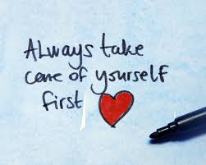
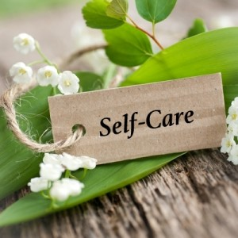
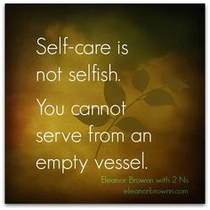
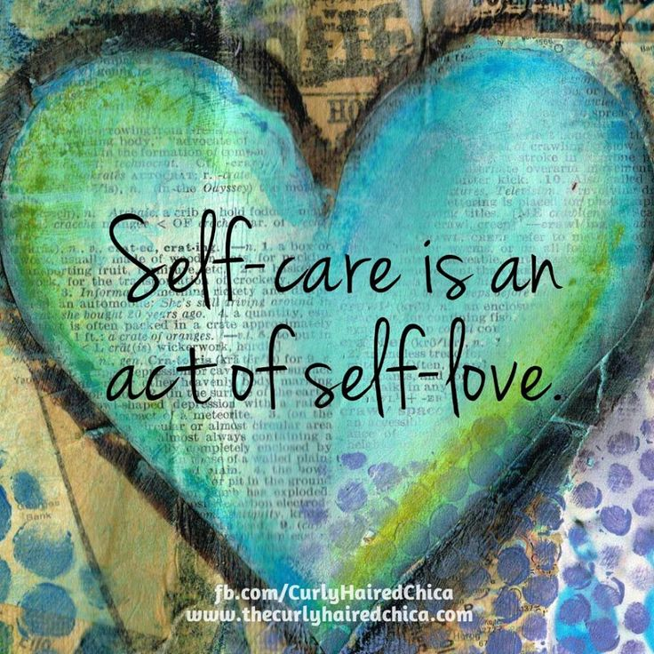

Self-care
Notes:
Moving on to self-care…

Slide 28
What is Self-Care and why is it so important?
Self-care is our ability as human beings to function effectively in the world while meeting the multiple challenges of daily life with a sense of energy, vitality, and confidence
Self-care is important for your physical health as well as your mental, spiritual, and lifestyle health. It requires active engagement
Notes:
What and Why?

Slide 29
Why?
Without self-care, relationships can suffer
Self-care makes us more effective and energetic
Self-care produces positive feelings, which improve confidence and self-esteem too
Notes:
Unhealthy relationships come about when you don’t take time for your own needs. We can also model this behavior which shows others that they too need to put themselves first and not overextend or overwork
It is not selfish or inconsiderate, we benefit greatly from taking good care of ourselves
We need to maintain a healthy relationship with ourselves and practice self-love; when we avoid activities that make us feel mentally and physically well, it tends to deplete our confidence and self-esteem

Slide 30
How do we practice self-care?
Make a date with yourself
Praise yourself when you do something awesome
Unplug
Journal
Meditate
Take a class for fun, something that feeds your soul
Take a quick nap
Eat something you enjoy
Take a long bath or shower
Do a mini-declutter
Help someone/ do a RAOK
Run or walk for a few minutes
Touch a pet
Spend time with real friends and other people who lift you up
Notes:
These are just a few ideas… do what feels best for you and brings you joy.

Slide 31
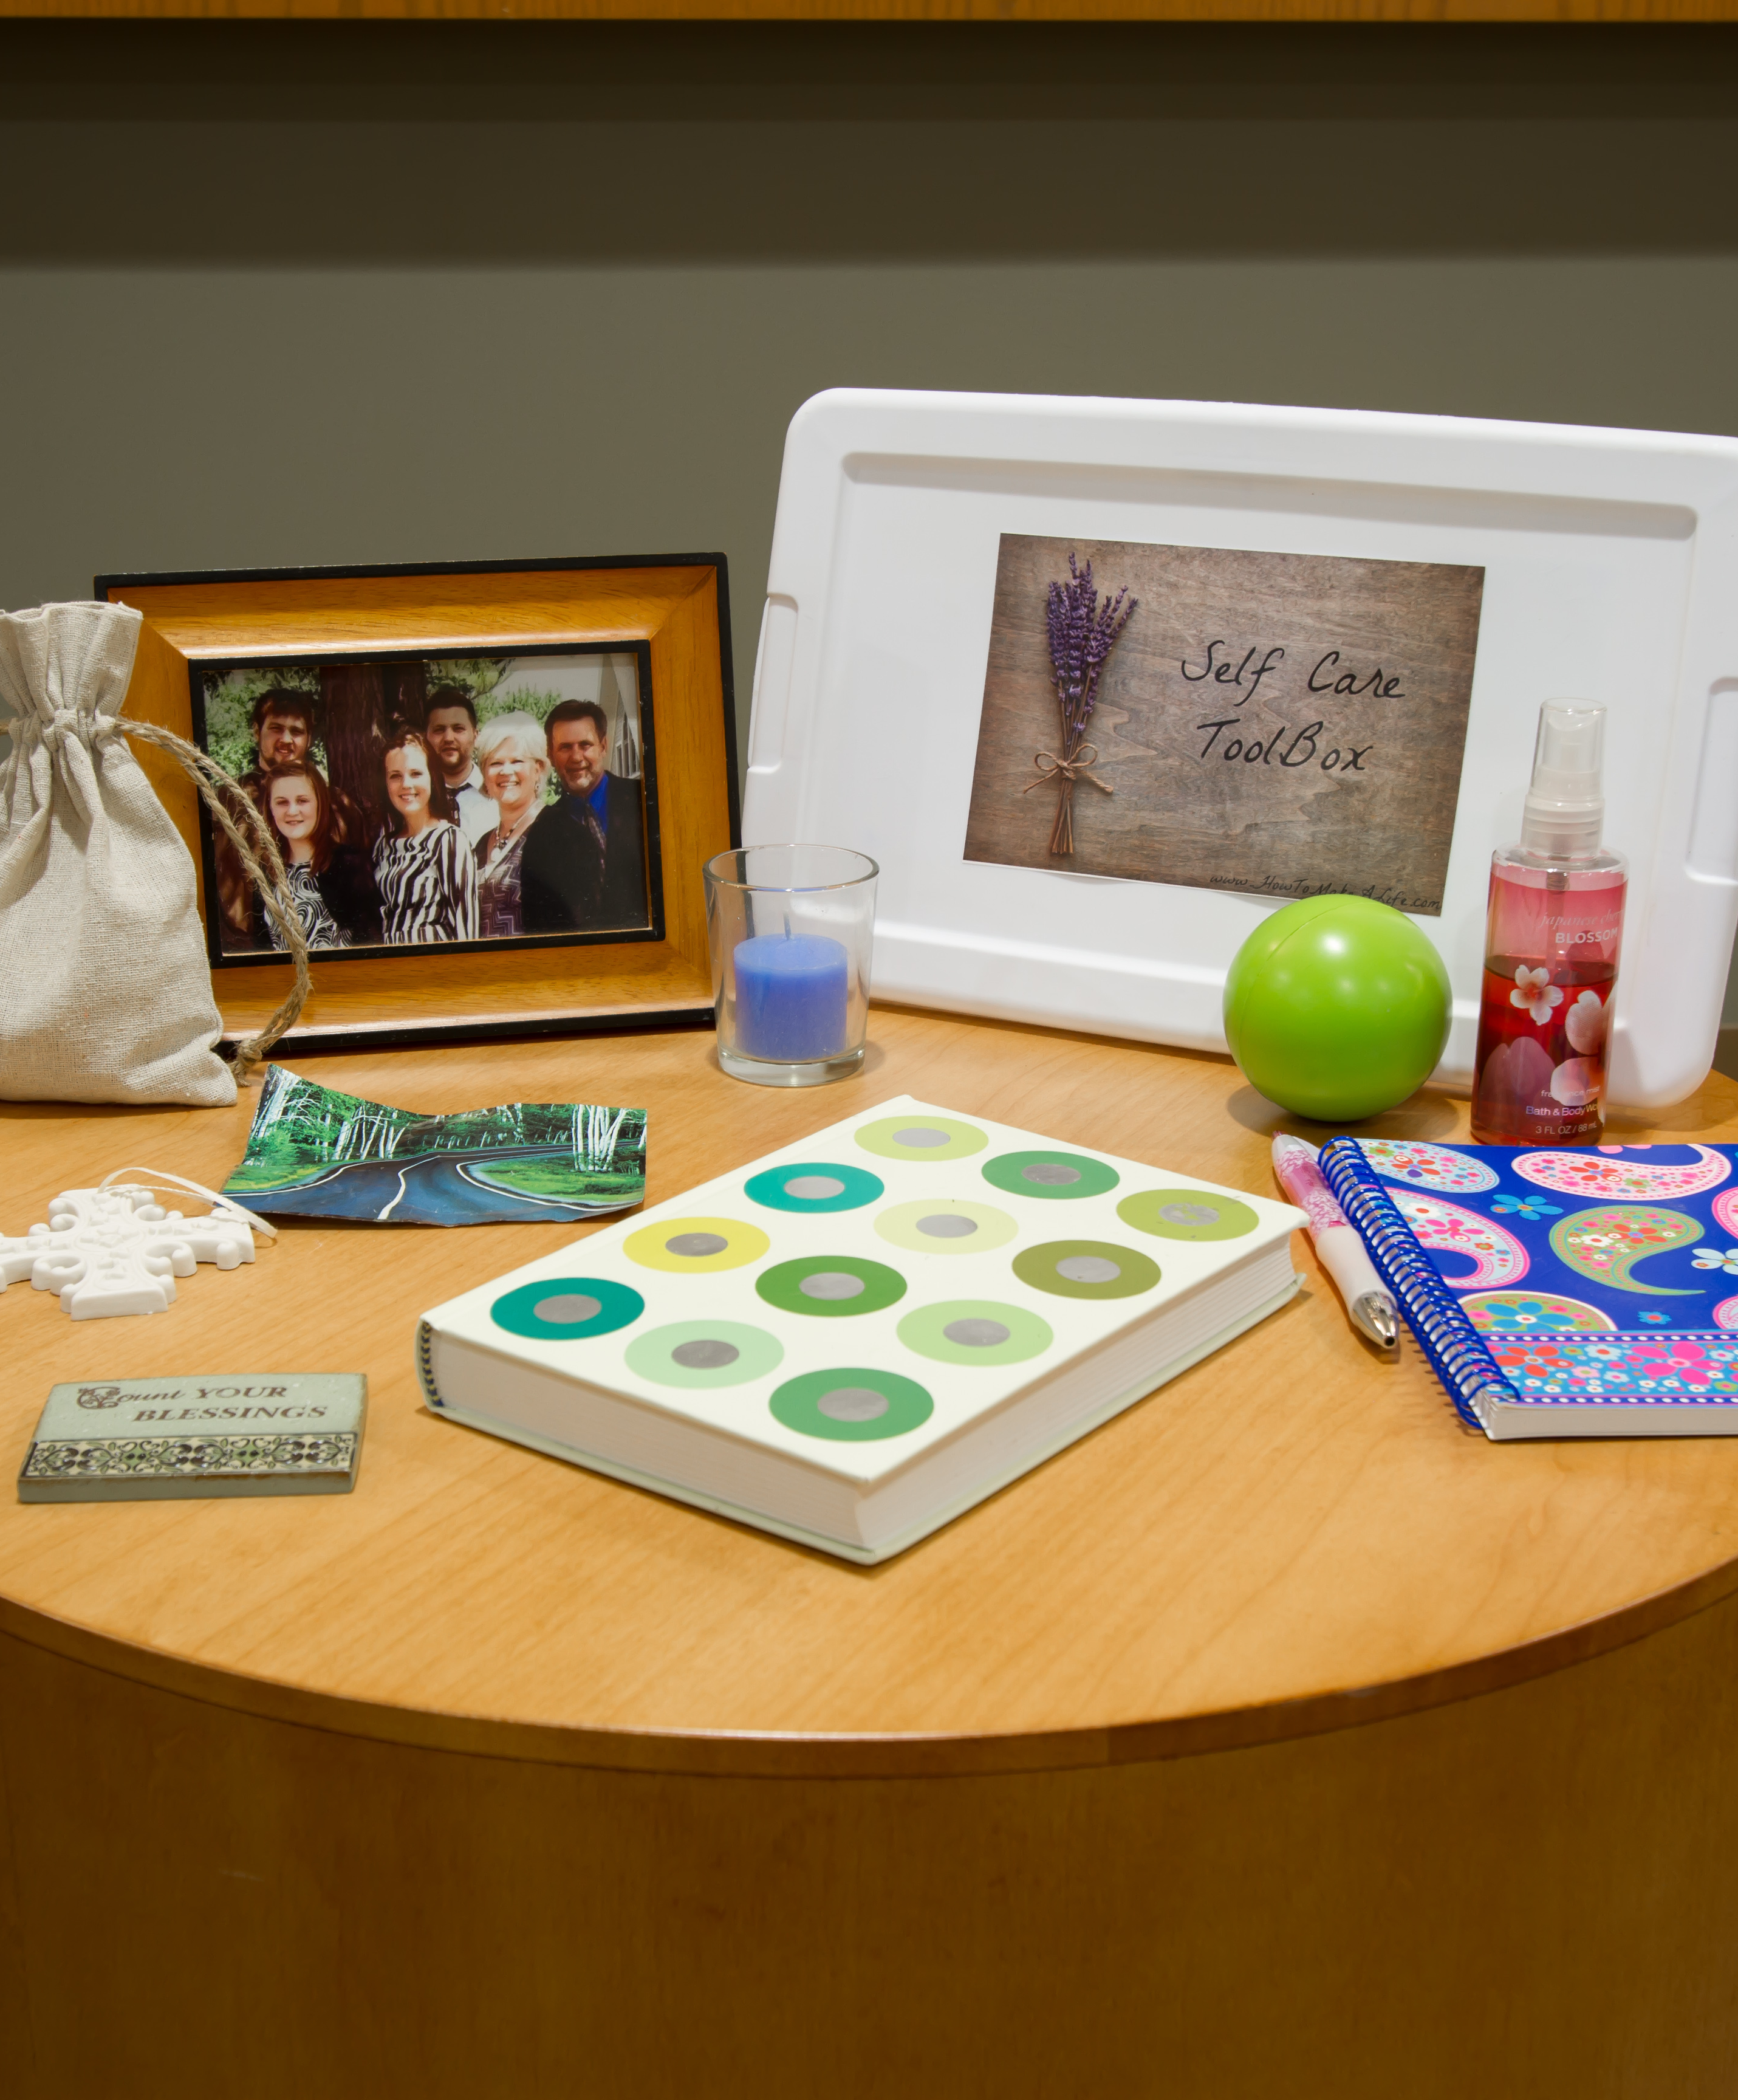
Create a self-care box!
Create one for yourself or to share with someone you care about
Add items that bring you joy, calm you, spark wonderful memories or satisfy your taste buds!
Keep it handy so you can use it on “mad, bad, and sad” days
Notes:
Try creating a self-care box! Make one for you and for someone important to you. Fill it with things that bring you joy so that it is ready for you to use on your most challenging days. Imagine that you have a really tough day and when you need it most, this self-care box will be ready with all the things that can bring you happiness and turn that tough day around!

Slide 32
Want to Become Part of the Movement?
Text bounceback to: 833-956-0928
Like us on Facebook:
Bounce Back Project
Check out our web pages: www.bouncebackproject.org
Sign up for newsletter: https://bit.ly/3wVS3zo

