Slide 1



Notes:
Share Bounce Back Project history and why it began… started in Wright County MN in 2015 following the loss of 2 prominent physicians. (See BBP beginnings notes in training manual)

Slide 2



Slide 3

What is Bounce Back
Project?
Unique collaborative of physicians, nurses, healthcare leaders and community members
Single purpose – to impact the lives of individuals, communities, and organizations by promoting health through happiness
Notes:
What is Bounce Back Project?

Slide 4
Bounce Back project Tools
Purpose: to expand resilience by retraining our mind to focus on the positive, increase the feelings of well-being and decrease the feelings of depression
  Random Acts of Kindness
  Three Good Things
  Gratitude
  Social Connections
  Mindfulness and Self-Care
  Purpose
Notes:
Why and How?

Slide 5
Three Good Things

Slide 6
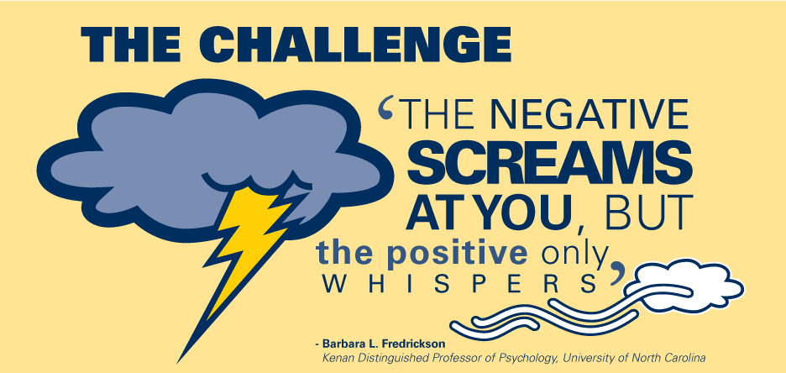
Notes:
We know that when something negative happens in our life, it consumes us…it consumes our thoughts and actions, sometimes for a very long time. It distracts us from our daily activities, personally and professionally. The negatives are big and bold.

Slide 7
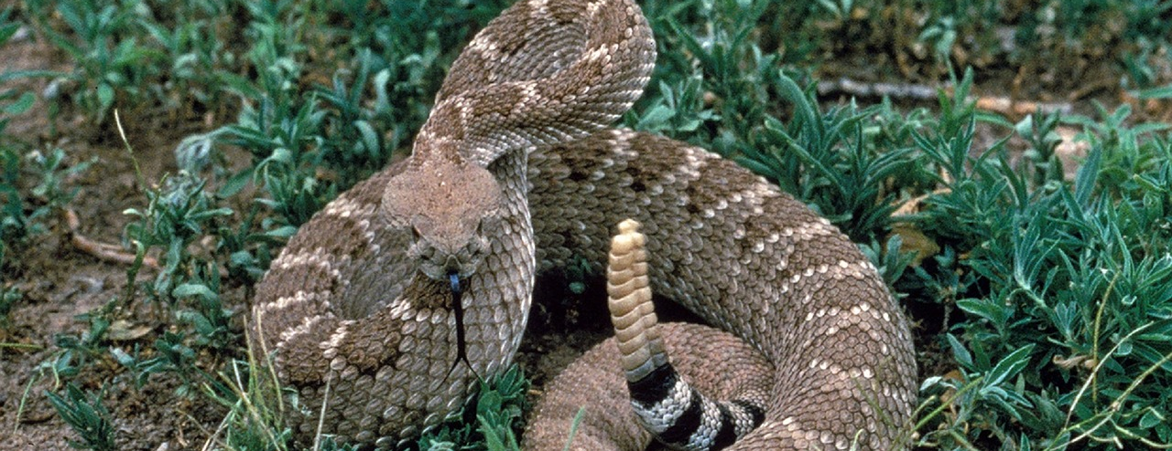
Negativity Is Hardwired
Notes:
We will remember bad things forever…ie the sound of a rattlesnake even when we are old and demented and can’t remember the names of our kids. We often can’t remember a good joke, because it has not genetically important to us. We get focused on the negative – our human brains are hardwired to remember the negative. This will protect us from harm, danger, injury, and illness… which is good, but doesn’t allow us to move forward easily. We have to be very intentional about focusing on the positives!

Slide 8
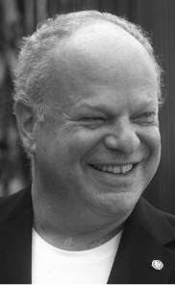

Three Good Things
Notes:
Three good things, or three blessings was first researched by Marty Seligman at the University of Pennsylvania. He is noted as the father of positive psychology and has done much research around it. It was noted that our minds tend to perseverate on what we were thinking about just prior to sleep each night. So there is some truth to the saying that someone fell asleep on their books and learned by osmosis. The best time to study and retain is right before sleep. This intervention works by writing down three things that have happened to you in the last day sometime within a couple hours of sleep. This has shown to improve happiness and outlook on life.
Other options could be to share your 3 good things around the supper table, as your tuck your children into bed (encouraging the next generation to focus on the good things in their day!), as you text your teenagers/aging parents, or as your start your work meetings.

Slide 9
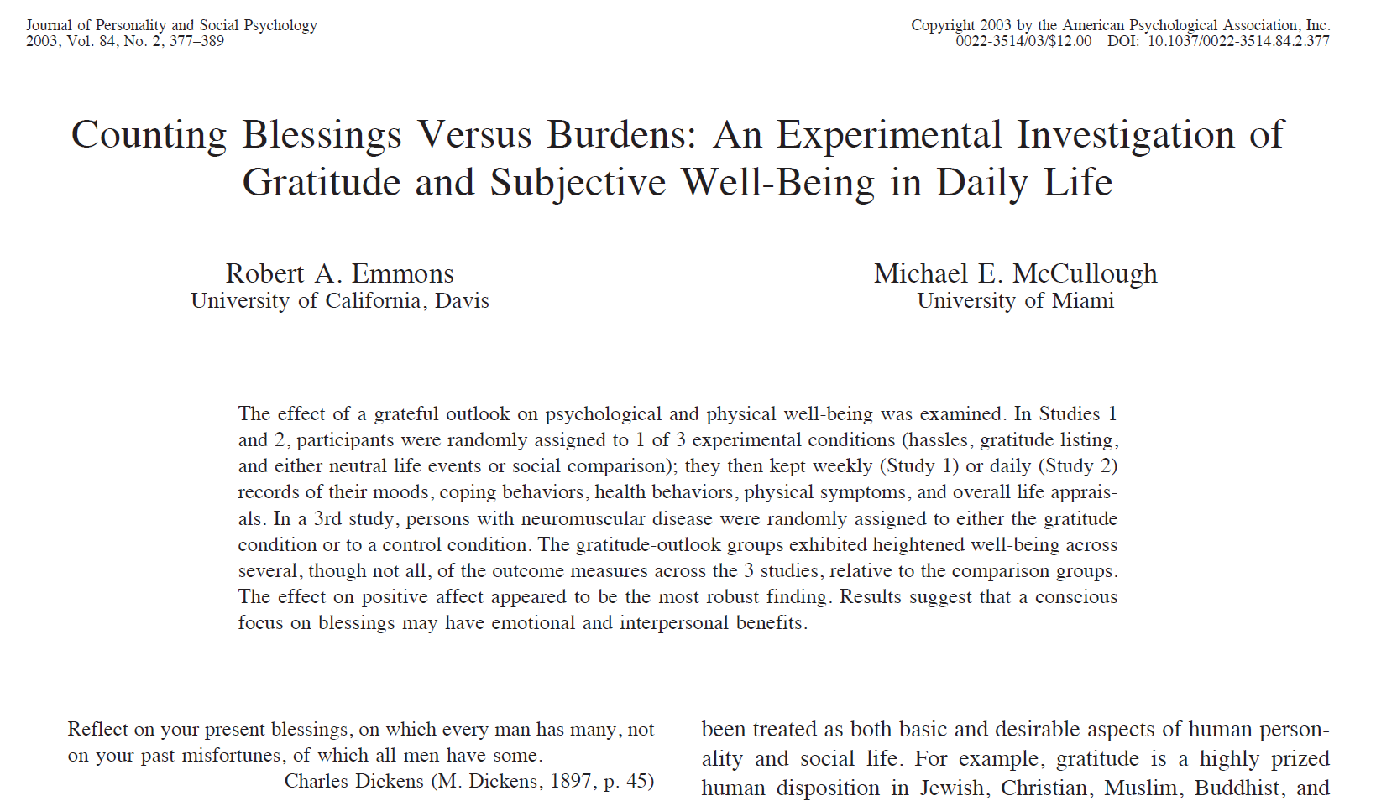
led to increases in positive affect, as well as reductions in negative affect, mediational analyses showed that gratitude was uniquely responsible for the effect of the intervention on positive affect. In addition, the gratitude intervention improved people’s amount of sleep and the quality of that sleep. Furthermore, the effects on well-being were apparent to the participants’ spouse or significant other.
Notes:
Why not try it? In addition, the gratitude intervention also appears to have improved people’s ability to get good night sleep and the quality of that sleep.
Furthermore, the effects on well-being (positive affect and life satisfaction) were apparent to the participants’ spouse or significant
other. “Counting blessings” is proven by research to increase life satisfaction and happiness.

Slide 10
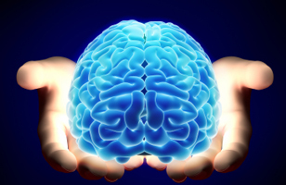
Three Good Things
Notes:
Mental health professionals and psychologists were really good at taking really depressed patients, from a negative 10 to a 0 (surviving) but not very good at taking them to thriving and having a positive outlook on life. Recent specialty of positive psychology started to take hold about 15 years ago when Marty Seligman became president of APA.

Slide 11
What Is “Three Good Things”?
Just before bed, ask yourself “What are three things that went well today, and what is my role in making them happen?”
You remember best what you've reviewed during your last two wakeful hours
For best results, write it down
Repeat for two weeks to make effects last longer
Notes:
(Or any time of the day…) Writing down 3 good things each day for 2 weeks has been proven to be as effective for depression/anxiety as taking SSRI’s (Prozac, Zoloft) and it starts to work quickly. The providers at our local clinics actually “prescribe” this to their patients!
How? Over the course of 2 weeks you are “retraining” your brain to focus on the good things – things that are right on front of you every day! Things like a beautiful sunrise or good cup of coffee in the morning. All green lights on the drive to work, snuggles and laughter from your young children, or a great walk with the dog…we all have so many positive things in our days, we just need to find them! Over the course of 2 weeks, you will start looking for 3 good things as you know you will need to write them down later. This effect is long lasting, you will continue to find the good in your day, hopefully for many months!

Slide 12
Research and Clinical
Trial Based Results
Lower burn-out and depression
Better work-life balance
Less conflict at work
Higher levels of happiness
Improved sleep quality

Slide 13
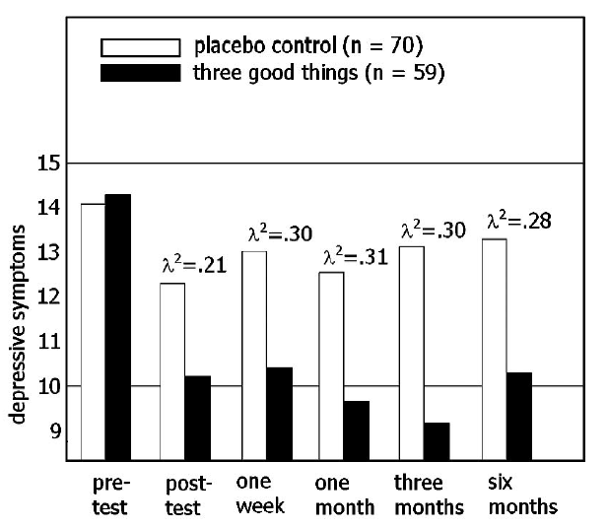
Three good things
Seligman, Steen, Park & Petersen, 2005
Notes:
As you can see on this graph, depression is very high before completing the 3 Good Things exercise, then decreases significantly for several months!

Slide 14
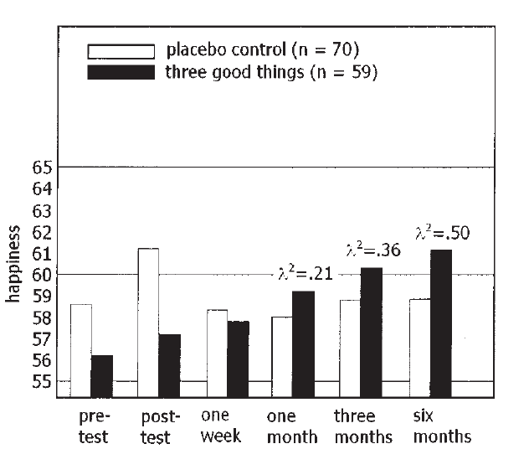
Three good things
Seligman, Steen, Park & Petersen, 2005
Notes:
Happiness is very low, but steadily increases over the next 6 months as you continue to find the god things in your everyday life! So simple and long lasting.

Slide 15
The Science of the Good Life: How one school increased student happiness with one simple exercise
The Science of the Good Life
Notes:
Click on the hyperlink to view the video (you will need to be connected to wi-fi to view)

Slide 16
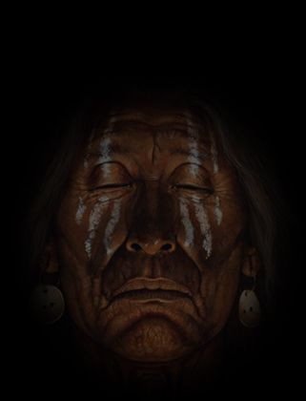
The Two Wolves Cherokee Legend
An old Cherokee is teaching his grandson about life. "A fight is going on inside me," he said to the boy.
"It is a terrible fight and it is between two wolves. One wolf is evil - he is anger, envy, sorrow, regret, greed, arrogance, self-pity, guilt, resentment, inferiority, lies, false pride, superiority, and ego." He continued, "The other is good - he is Joy, Gratitude, Serenity, Interest, Hope, Pride, Amusement, Inspiration, Awe, Love, and Faith. The same fight is going on inside you grandson - and inside every other person, too.”
The grandson thought about it for a minute and then asked his grandfather:
Notes:
An old Cherokee is teaching his grandson about life. "A fight is going on inside me," he said to the boy.
"It is a terrible fight and it is between two wolves. One wolf is evil - he is anger, envy, sorrow, regret, greed, arrogance, self-pity, guilt, resentment, inferiority, lies, false pride, superiority, and ego." He continued, "The other is good - he is Joy, Gratitude, Serenity, Interest, Hope, Pride, Amusement, Inspiration, Awe, Love, and faith. The same fight is going on inside you grandson - and inside every other person, too."
The grandson thought about it for a minute and then asked his grandfather: Which wolf will win…..his grandfather replied….the one you feed

Slide 17
"Which wolf will win?"
The old Cherokee simply replied,
"The one you feed."
Notes:
An old Cherokee is teaching his grandson about life. "A fight is going on inside me," he said to the boy.
"It is a terrible fight and it is between two wolves. One wolf is evil - he is anger, envy, sorrow, regret, greed, arrogance, self-pity, guilt, resentment, inferiority, lies, false pride, superiority, and ego." He continued, "The other is good - he is Joy, Gratitude, Serenity, Interest, Hope, Pride, Amusement, Inspiration, Awe, Love, and faith. The same fight is going on inside you grandson - and inside every other person, too."
The grandson thought about it for a minute and then asked his grandfather: Which wolf will win…..his grandfather replied….the one you feed
Will you feed your negative or your positive?

Slide 18
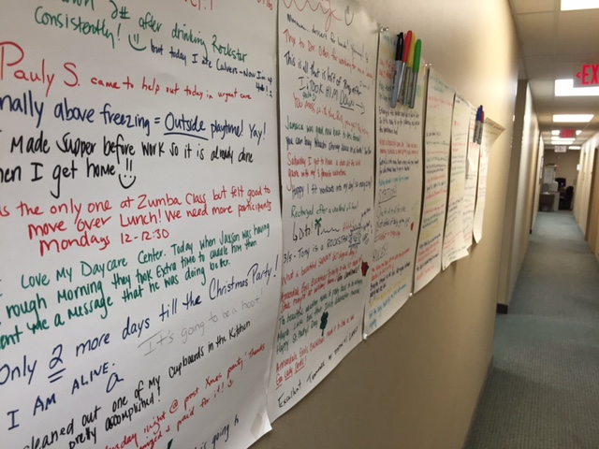
Notes:
You can use this tool in many ways, the most researched is right before bed but other variations are out there. The doctors at the Buffalo Clinic have taken to putting up butcher paper in the back hallway and writing good things on the wall for all to see. Others have used it at the dinner table with their family or also using it at bedtime with their kids. Many people at the hospital are starting their meetings with three good things. Docs are asking their patients to list good things before they start with their regular appt or are prescribing this as a treatment for depression/anxiety and just for everyone to improve overall happiness. All these things have benefits, so please don’t feel like the only time this tool is useful is prior to bed.

Slide 19

Three Good Things
Everyone think of one good thing that happened to you today
Notes:
We are going to do a slight version of this tool. I want everyone to think of one good thing that happened to you today. Keep in mind that good things do not have to be BIG things, they can be simple and still make your day. You will find, especially as you get older, that good things come in many packages. Sometimes when you are older, just having enough gas in the car is a good thing, or having good health, or spending time with your family. It’s important to find 3 good things every day.
Listing 3 Good Things about your day each night at bedtime has proven to significantly increase your happiness over the next 6 months!

Slide 20
The Best Things in Life are Free!
Hugs
Smiles
Friends
Kisses
Family
Sleep
Love
Laughter
Good Memories
Notes:
Sometimes on the most challenging days we have to go back to the basic good things in our life, and many of these are free! Remind others that these are free good things are always here for them!

Slide 21
Three Good Things in your life
Practice
Practice 3 Good Things for two weeks
Start
Start each gathering/meeting with 1 good thing that is happening for each attendee or 3 Good Things for the group
Discuss
Discuss how identifying the positives in one’s day can lead to better health and happiness and how it gets easier the more it is practiced
Notes:
How can you implement this in your life, both personally and professionally?

Slide 22
Want to Become Part of the Movement?
Text bounceback to: 833-956-0928
Like us on Facebook:
Bounce Back Project
Check out our web pages: www.bouncebackproject.org
Sign up for newsletter: https://bit.ly/3wVS3zo
Notes:
Ways to follow the work of Bounce Back Project and be aware of events happening in our communities.

