Slide 1



Notes:
Share the history of Bounce Back Project (see BBP Beginnings in training manual) – started in 2015 in Wright County MN after the loss of 2 local physicians…

Slide 2


What is Bounce Back Project?
Unique collaborative of physicians, nurses, healthcare leaders and community members
Single purpose – to impact the lives of individuals, communities, and organizations by promoting health through happiness
Notes:
What?

Slide 3

Bounce Back project Tools
Purpose: to expand resilience by retraining our mind to focus on the positive, increase the feelings of well-being and decrease the feelings of depression
Random Acts of Kindness
Three Good Things
Gratitude
Social Connections
Mindfulness and Self-Care
Purpose
Notes:
Why and How?

Slide 4
Purpose
Notes:
Purpose – one of the 5 pillars of resiliency and a huge component of our overall well-being.

Slide 5

Thought
We exist here on earth for an unknown length of time. While here we do many things…some will matter, some will not, some are important, and some are not. The important ones are the ones that make us happy, give us meaning, bring a smile to our face or to the face of others. All the other stuff us just wasting time.
Notes:
Manson, M (2014). 7 strange questions that help you find your lifes purpose. Retrieved from https://markmanson.net/life-purpose

Slide 6
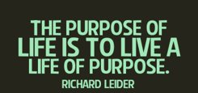
So what is purpose?
Purpose in life refers to a "feeling that there is meaning in one's present and past life."
Something that is instantly meaningful
Something that makes you come alive
Notes:
•William Damon, the director of the Stanford Center on Adolescence, defines purpose as “a stable and generalized intention to accomplish something that is at the same time meaningful to the self and consequential for the world beyond the self.”
Reference:
Ryff & Singer, 1998
Damon, Menon, Bronk, 2003
Damon, n.d.

Slide 7

4 key components to purpose
Dedicated commitment
Personal meaningfulness
Goal directedness
Vision larger than oneself
Notes:
•Truly finding one’s purpose requires four key components: dedicated commitment, personal meaningfulness, goal directedness, and a vision larger than oneself. These are not skills that typically get nurtured in American high schools today. Most of the high school experience is oriented around external achievement, checking off boxes, and short-term goal fulfillment.
Photo: This Photo by Unknown author is licensed under CC BY.

Slide 8
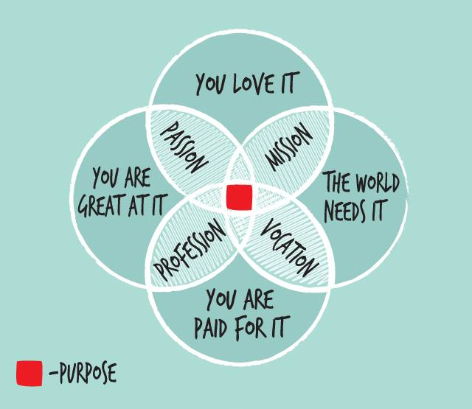
Notes:
How do you find your purpose? It is typically the “intersection” of these components of your life.

Slide 9
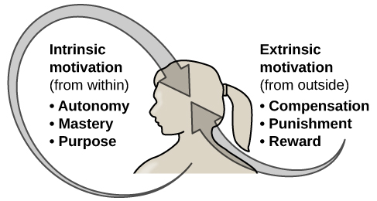
Why is purpose important?
Rates of mental illness are increasing
Decreased social connectedness
Increased perception of environmental threat
Increased emphasis on extrinsic rather than intrinsic rewards
People are fatigued and bored
Notes:
•Rates of mental health challenges are high and increasing (Twenge, 2010; Kessler et. al.,
•2004; Guthmnanet., 2010; Gallagher et. al., 2003).
•Much of this is due to:
Decreased social connectedness
increased perception of environmental
•threat
Increased emphasis on extrinsic rather
•than intrinsic rewards
Friedman, D. (2008). Book Review: The Path to Purpose. https://greatergood.berkeley.edu/article/item/book_review_path_purpose
One thing nearly all teens agree on is that most of what high school teaches them is irrelevant to their lives outside of school or their future careers. One study found that the most common feelings among high school students are fatigue and boredom.
Photo: This Photo by Unknown author is licensed under CC BY.

Slide 10
Just the facts
40% of Americans have NOT discovered a life purpose.
40% either do not think their lives have a clear sense of purpose or are neutral about whether their lives have purpose.
25% feel neutral or do not have a strong sense of what makes their lives meaningful
Research has shown that having purpose and meaning in life increases overall well-being and life satisfaction, improves mental and physical health, enhances resiliency, enhances self-esteem, and decreases the chances of depression.
Notes:
•about 4 out of 10 Americans have not discovered a satisfying life purpose. Forty percent either do not think their lives have a clear sense of purpose or are neutral about whether their lives have purpose. Nearly a quarter of Americans feel neutral or do not have a strong sense of what makes their lives meaningful. Research has shown that having purpose and meaning in life increases overall well-being and life satisfaction, improves mental and physical health, enhances resiliency, enhances self-esteem, and decreases the chances of depression. On top of that, the single-minded pursuit of happiness is ironically leaving people less happy, according to recent research. "It is the very pursuit of happiness," Frankl knew, "that thwarts happiness."Smith, E. E. (2013). There’s more to life then being happy. Retrieved from https://www.theatlantic.com/health/archive/2013/01/theres-more-to-life-than-being-happy/266805/
Kobau, R.,Sniezek, J., Zack, M. M., Lucas, R. E., & Burns, A. (2010). Well being assessment: An evaluation of well-being scales for public health and population estimates of well being among US adults. Applied Psychology, 2(1), 272-297

Slide 11
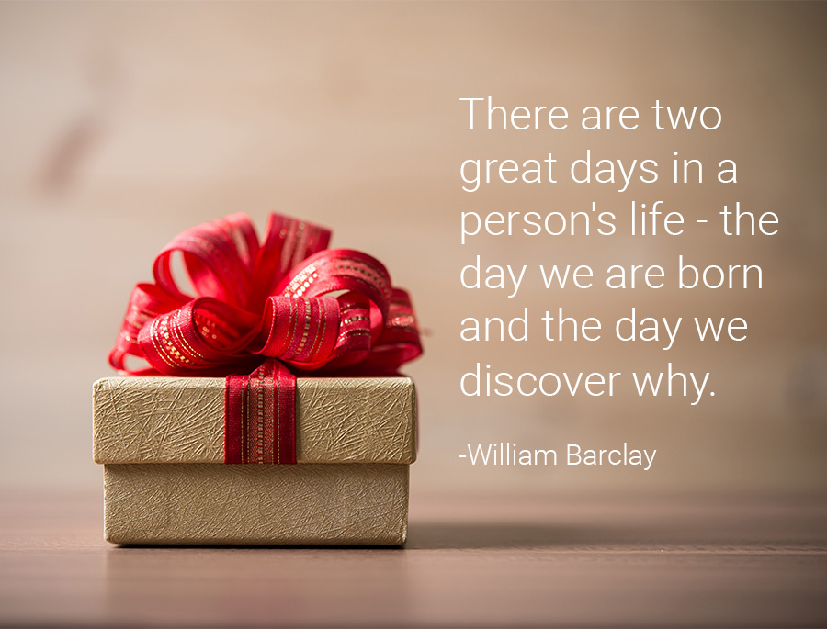
Notes:
Having purpose is essential to our well-being. It can change throughout our lifetime and we can certainly have more than one purpose!

Slide 12
Positives of Purpose
Add 2 years to your life!!
Help decrease things that distract you
Increase your resilience
Reduce pain
Cancer regression
Notes:
People who report a strong sense of purpose are 15% less likely to die in the same time frame that their peers without a sense of purpose..this applies to all age group!
Those report a strong sense of purpose live an average of 2 years longer
Reduced pain
Better heart health
Regression of some cancers
Have a sense of purpose provides motivations
Having a purpose keeps a person focused, they become less distracted by what is not important
Having a purpose increases resilience, providing determination and endurance to keep going.
Adults with a sense of purpose report greater satisfaction with life.
Taylor, S. (2016). A model of purpose: From survival to transpersonal purpose. Transpersonal Psychology Review, 18(1). Retrieved from https://www.bps.org.uk/publications/transpersonal-psychology-review
Bernard, 1991
Hill, Burrow & Bronk 2014
Whitlock, J. (n.d.). Cultivating a sense of purpose inyouth. Power point from the Bronfenbrenner center for translational research. http://www.actforyouth.net/resources/pd/pd14-purpose.pdf
Damon, W. (2008). The Path to Purpose: Helping Our Children Find Their Calling in Life

Slide 13
Research shows…
Development of purpose is necessary to develop one’s identity
Research shows that teens and young adults that seek purpose report higher life satisfaction and levels of happiness.
New research even suggests that a feeling of purpose in young people is associated with better physical health.
Notes:
Cook-Deegan, P. (2015). How teens find purpose. Greater Good Magazine. https://greatergood.berkeley.edu/article/item/how_to_help_teens_find_purpose

Slide 14
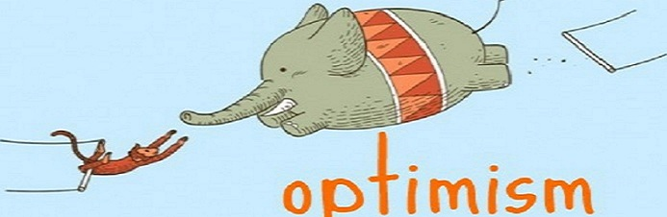
Purpose Provides
Notes:
Optimism and hope, having a purpose provides an attainable goal.
Taylor, S. (2016). A model of purpose: From survival to transpersonal purpose. Transpersonal Psychology Review, 18(1). Retrieved from https://www.bps.org.uk/publications/transpersonal-psychology-review
Photo reference:
https://www.google.com/imgres?imgurl=https%3A%2F%2Fqph.fs.quoracdn.net%2Fmain-qimg-c600a391fa283146c18a9e89cfb3aa82&imgrefurl=https%3A%2F%2Fwww.quora.com%2FWhats-difference-between-the-optimistic-and-the-positive-one&docid=DZW-xib9IMi0ZM&tbnid=Tl8VYdc4AkWPQM%3A&vet=10ahUKEwjajY_LiInfAhUG3IMKHYJ7CKgQMwhzKAswCw..i&w=602&h=339&bih=973&biw=1920&q=optimism&ved=0ahUKEwjajY_LiInfAhUG3IMKHYJ7CKgQMwhzKAswCw&iact=mrc&uact=8

Slide 15

Purpose Provides
A sense of something bigger!
Notes:
Feel less self centered, allows us to feel like we are part of something bigger, this also increases our sense of well being.
Taylor, S. (2016). A model of purpose: From survival to transpersonal purpose. Transpersonal Psychology Review, 18(1). Retrieved from https://www.bps.org.uk/publications/transpersonal-psychology-review
Photo reference:
https://www.google.com/imgres?imgurl=https%3A%2F%2Fi.ytimg.com%2Fvi%2FwCUlvBrLoYk%2Fmaxresdefault.jpg&imgrefurl=https%3A%2F%2Fwww.youtube.com%2Fwatch%3Fv%3DwCUlvBrLoYk&docid=8pvE6LkwNC66bM&tbnid=126GyV9KEMIfLM%3A&vet=10ahUKEwjM_MyVh4nfAhUI5IMKHWFWAi0QMwh1KAwwDA..i&w=1920&h=1080&bih=973&biw=1920&q=stars&ved=0ahUKEwjM_MyVh4nfAhUI5IMKHWFWAi0QMwh1KAwwDA&iact=mrc&uact=8

Slide 16

Purpose increases acceptance
The Harvard’s men's study found that those who reflect on their purpose had fewer negative feelings and discomfort with diversity.
Notes:
The Harvards mens study found that reflecting on purpose weakened negative feelings and discomfort with diversity......
Whitlock, J. (n.d.). Cultivating a sense of purpose inyouth. Power point from the Bronfenbrenner center for translational research. http://www.actforyouth.net/resources/pd/pd14-purpose.pdf
Photo: This Photo by Unknown author is licensed under CC BY-

Slide 17
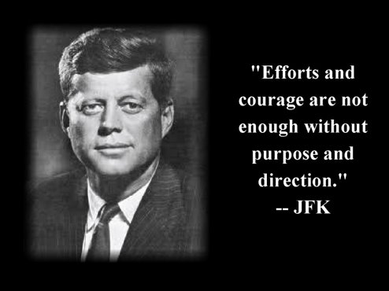
Purpose Provides
Motivation
Focus
Resilience
Determination
Sense of Wellbeing
Positivity
Notes:
Optimism and hope, having a purpose provides an attainable goal.
Purpose enhances self esteem, feel a sense of competence and achievement
Purpose provides resistance to psychological discord, things like depression and anxiety, boredom and frustration.
Purpose promotes positivity
Main purpose for many is SURVIVAL
Will we have enough food, water, shelter, security
People find purpose in religion, it provides a framework to follow
Once survival is met humans need to transfer to a different type of purpose. When survival is met humans lose motivation and stop looking for purpose
Taylor, S. (2016). A model of purpose: From survival to transpersonal purpose. Transpersonal Psychology Review, 18(1). Retrieved from https://www.bps.org.uk/publications/transpersonal-psychology-review

Slide 18

How can we find purpose?
Notes:
Photo reference: https://www.bing.com/images/search?view=detailV2&ccid=6hGGjvVn&id=DDD979BF9AFCAC2283295786D28745A5CB12124F&thid=OIP.6hGGjvVnd2rHCuQFU6KiFgHaEL&mediaurl=http%3a%2f%2fil7.picdn.net%2fshutterstock%2fvideos%2f5964935%2fthumb%2f2.jpg&exph=480&expw=852&q=Peek+Under+Bed&simid=608012040111457147&selectedIndex=5&ajaxhist=0

Slide 19
Do you often wonder or think...
What do I want to do with my life
I don’t have a clue ...
What am I passionate about
Do you think you will know when you are 20, 30….50??

Slide 20
Things to get you thinking…
1. What makes you smile?
2. What activities make you lose track of time?
3. What makes you feel great about yourself?
4. Who inspires you most? Which qualities inspire you, in each person?
5. What are you naturally good at?
6. What are you good at giving or doing for others?
7. What are some challenges, difficulties and hardships you’ve overcome or are in the process of overcoming? How did you do it?
Notes:
3-4 minutes to complete. (Do this activity with your group if you have time)
Write the answers to each question down. Write the first thing that pops into your head. Write without editing. It’s important to write out your answers rather than just thinking about them. Write quickly. Give yourself less than 60 seconds a question. Preferably less than 30 seconds. Be honest. Nobody will read it. Enjoy the moment and smile as you write.
1. What makes you smile? (Activites, people, events, hobbies, projects, etc.)
2. What activities make you lose track of time?
3. What makes you feel great about yourself?
4. Who inspires you most? (Anyone you know or do not know. Family, friends, authors, artists, leaders, etc.) Which qualties inspire you, in each person?
5. What are you naturally good at? (Skills, abilities, gifts.)
6. What are you good at giving or doing for others?
7. What are some challenges, difficulties and hardships you’ve overcome or are in the process of overcoming? How did you do it?
9. Imagine you are now 90 years old, sitting a rocking chair outside your porch; you can feel the spring breeze gently brushing against your face. Looking back at your life, what matters you most? List them out.
Whitlock, J. (n.d.). Cultivating a sense of purpose inyouth. Power point from the Bronfenbrenner center for translational research. http://www.actforyouth.net/resources/pd/pd14-purpose.pdf

Slide 21

What is Your Purpose in Life?
Notes:
Great short video! (Must be connected to wi-fi)

Slide 22
Life should not be a journey to the grave with the intention of arriving safely in a pretty and well-preserved body, but rather to skid in broadside in a cloud of smoke, thoroughly used up, totally worn out, and loudly proclaiming ​
"Wow! What a Ride!” ​
Hunter S. Thompson

Slide 23
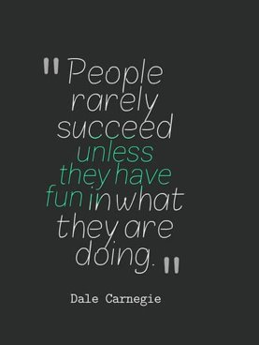
How do we find purpose?
Get up and get out, experience as many new things as possible until you find something that is important to you.
Notes:
This could cause some embarrassment.
But if you don’t try it how will you ever know you don’t like it?
What did this make you think of?
Why haven’t you tried it?
Do words like….My friends would think I am crazy or my parents or partner would hate that?
Maybe it is not the activity itself but what is behind it?
For example with video games, is it really the game or is it the competition, or the drive to get to the next level or build the next structure? (Manson, M (2014). 7 strange questions that help you find your lifes purpose. Retrieved from https://markmanson.net/life-purpose)

Slide 24
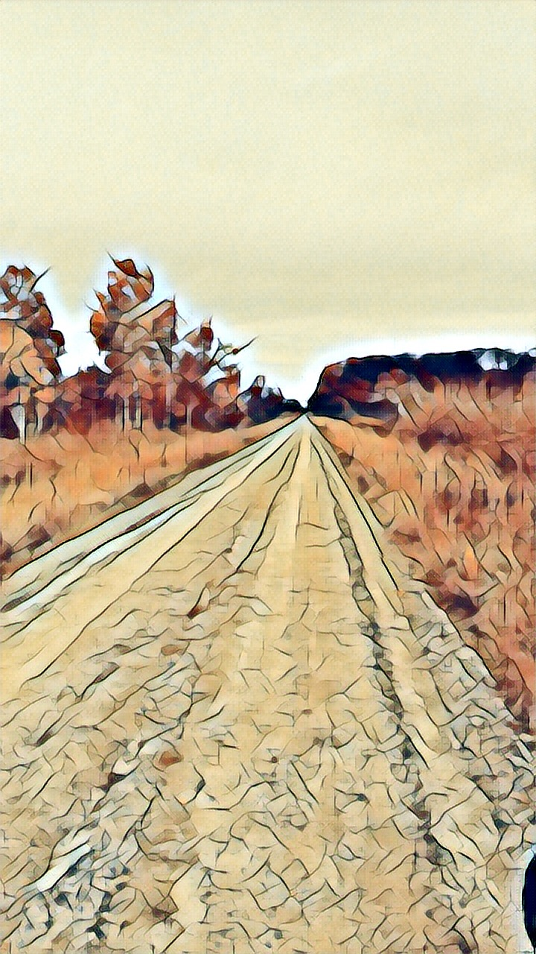
Finding purpose can be tough
Let's be honest, life is not always fun and games and the road gets rough, even when we are at our best.
Notes:
What are you willing to sacrifice or give up to make through those bumpy times in life? Or if you think of it another way what are you willing to tolerate to get over the rough road on your path to happiness?
Example: You know you want to be the next Steve Jobs, but the path to get to what you really want is full of learning, trying new things and failing at some of those things.
Photo reference: L. Zobel (2017)

Slide 25
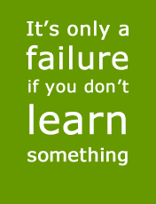
Failure IS NOT A dirty word
Failure is success that has not
happened yet
Notes:
Failure is NOT a bad word. It means you are learning!!
Success means you are proving that you can do something you know…..THIS IS NOT AN EXCUSE IF YOU FAIL an EXAM…
Example……..Ask anyone who rides a horse really well….ask them how many times they had to ride to be good, or if they were ever thrown off the horse, or stepped on…..they had many failed rides before they became good.
Other examples….cooks with scars from ovens, knives.
A painter, an artist, your grandma and your favorite dish, ask her how long it took to get the recipe perfect.
Carroll, J (2006). Failure is a good thing. Retrieved from https://www.npr.org/templates/story/story.php?storyId=6196795
•Learning from failure: But failure is how we learn. Paul Tough documents this well—how learning to fail builds up critical life skills. It is hard to think of a political leader or anyone who ever accomplished anything important who did not fail along the way—in fact, failure was often a catalyst for their eventual success. Learning how to persevere is often the most important part of this process. But we do not give students the opportunity to fail without serious consequences. So when they get out into the real world they cannot deal with failure.
Failure is sucsess that has not happened yet
Photo reference: This Photo by Unknown author is licensed under CC BY-SA-NC.

Slide 26
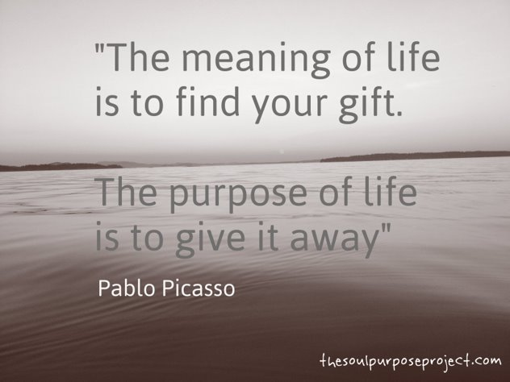

Slide 27
How to foster purpose
Model purpose
Foster gratitude
Ask about skills and talents
Ask how they hope to change the world
Listen to what they are saying
Allow for time to reflect on purpose
Notes:
•Model purpose. Talk about the things that fill your life with purpose. Why did you become a youth pastor? Does working with young people give you purpose? We rarely talk about these things, but doing so can provide young people with a language of purpose and help them reflect on the things that matter most in their lives.
•Foster gratitude. When we experience gratitude, we experience a blessing, and we should regularly reflect on the blessings in our lives. Doing so is not only a Christian imperative, but also, according to scientists, a contributor to a more fulfilling life. And, when we receive blessings, it is often because someone else has incurred a cost, whether it is their time, energy, or some other resource. We should reflect on that, too. Focusing on the blessings in our lives and on the people who bless us, our research finds, naturally inclines people to consider the ways they want to give back. This is a key part of a purposeful life.
•Ask young people about their skills and talents. We usually find purpose by applying our strengths. A young person strong in math and science may find purpose in becoming a doctor or nurse and providing compassionate care, whereas a budding musician may find purpose in creating music that moves others.
•Ask young people what they hope to change about the world. Rick Warren’s highly-acclaimed book, a Purpose-driven Life, sold over two million copies and spawned a cottage industry of purpose-seeking. The first sentence in his book? “It’s not about you.” A purpose in life is inspired by a desire to contribute to the broader world in some productive way, and to foster purpose, we need to encourage young people to think about how they want to give back.
•Talk to young people. And listen. Ask the young people in your congregation to imagine themselves at 40 years of age. Everything has gone according to plan. What will they be doing? Why? What will be important to them? Why? What values and beliefs are most central to who they are? Why? The why part is important. Purpose often emerges from the whys. And then listen. A purpose in life usually comes out in whispers. A comment here, and a question there. Adults need to be listening to hear these soft sounds and encourage them by directing young people to resources that can help them learn more about their emerging interests and purposes.
Whitlock, J. (n.d.). Cultivating a sense of purpose inyouth. Power point from the Bronfenbrenner center for translational research. http://www.actforyouth.net/resources/pd/pd14-purpose.pdf

Slide 28
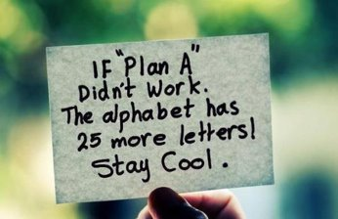

Slide 29
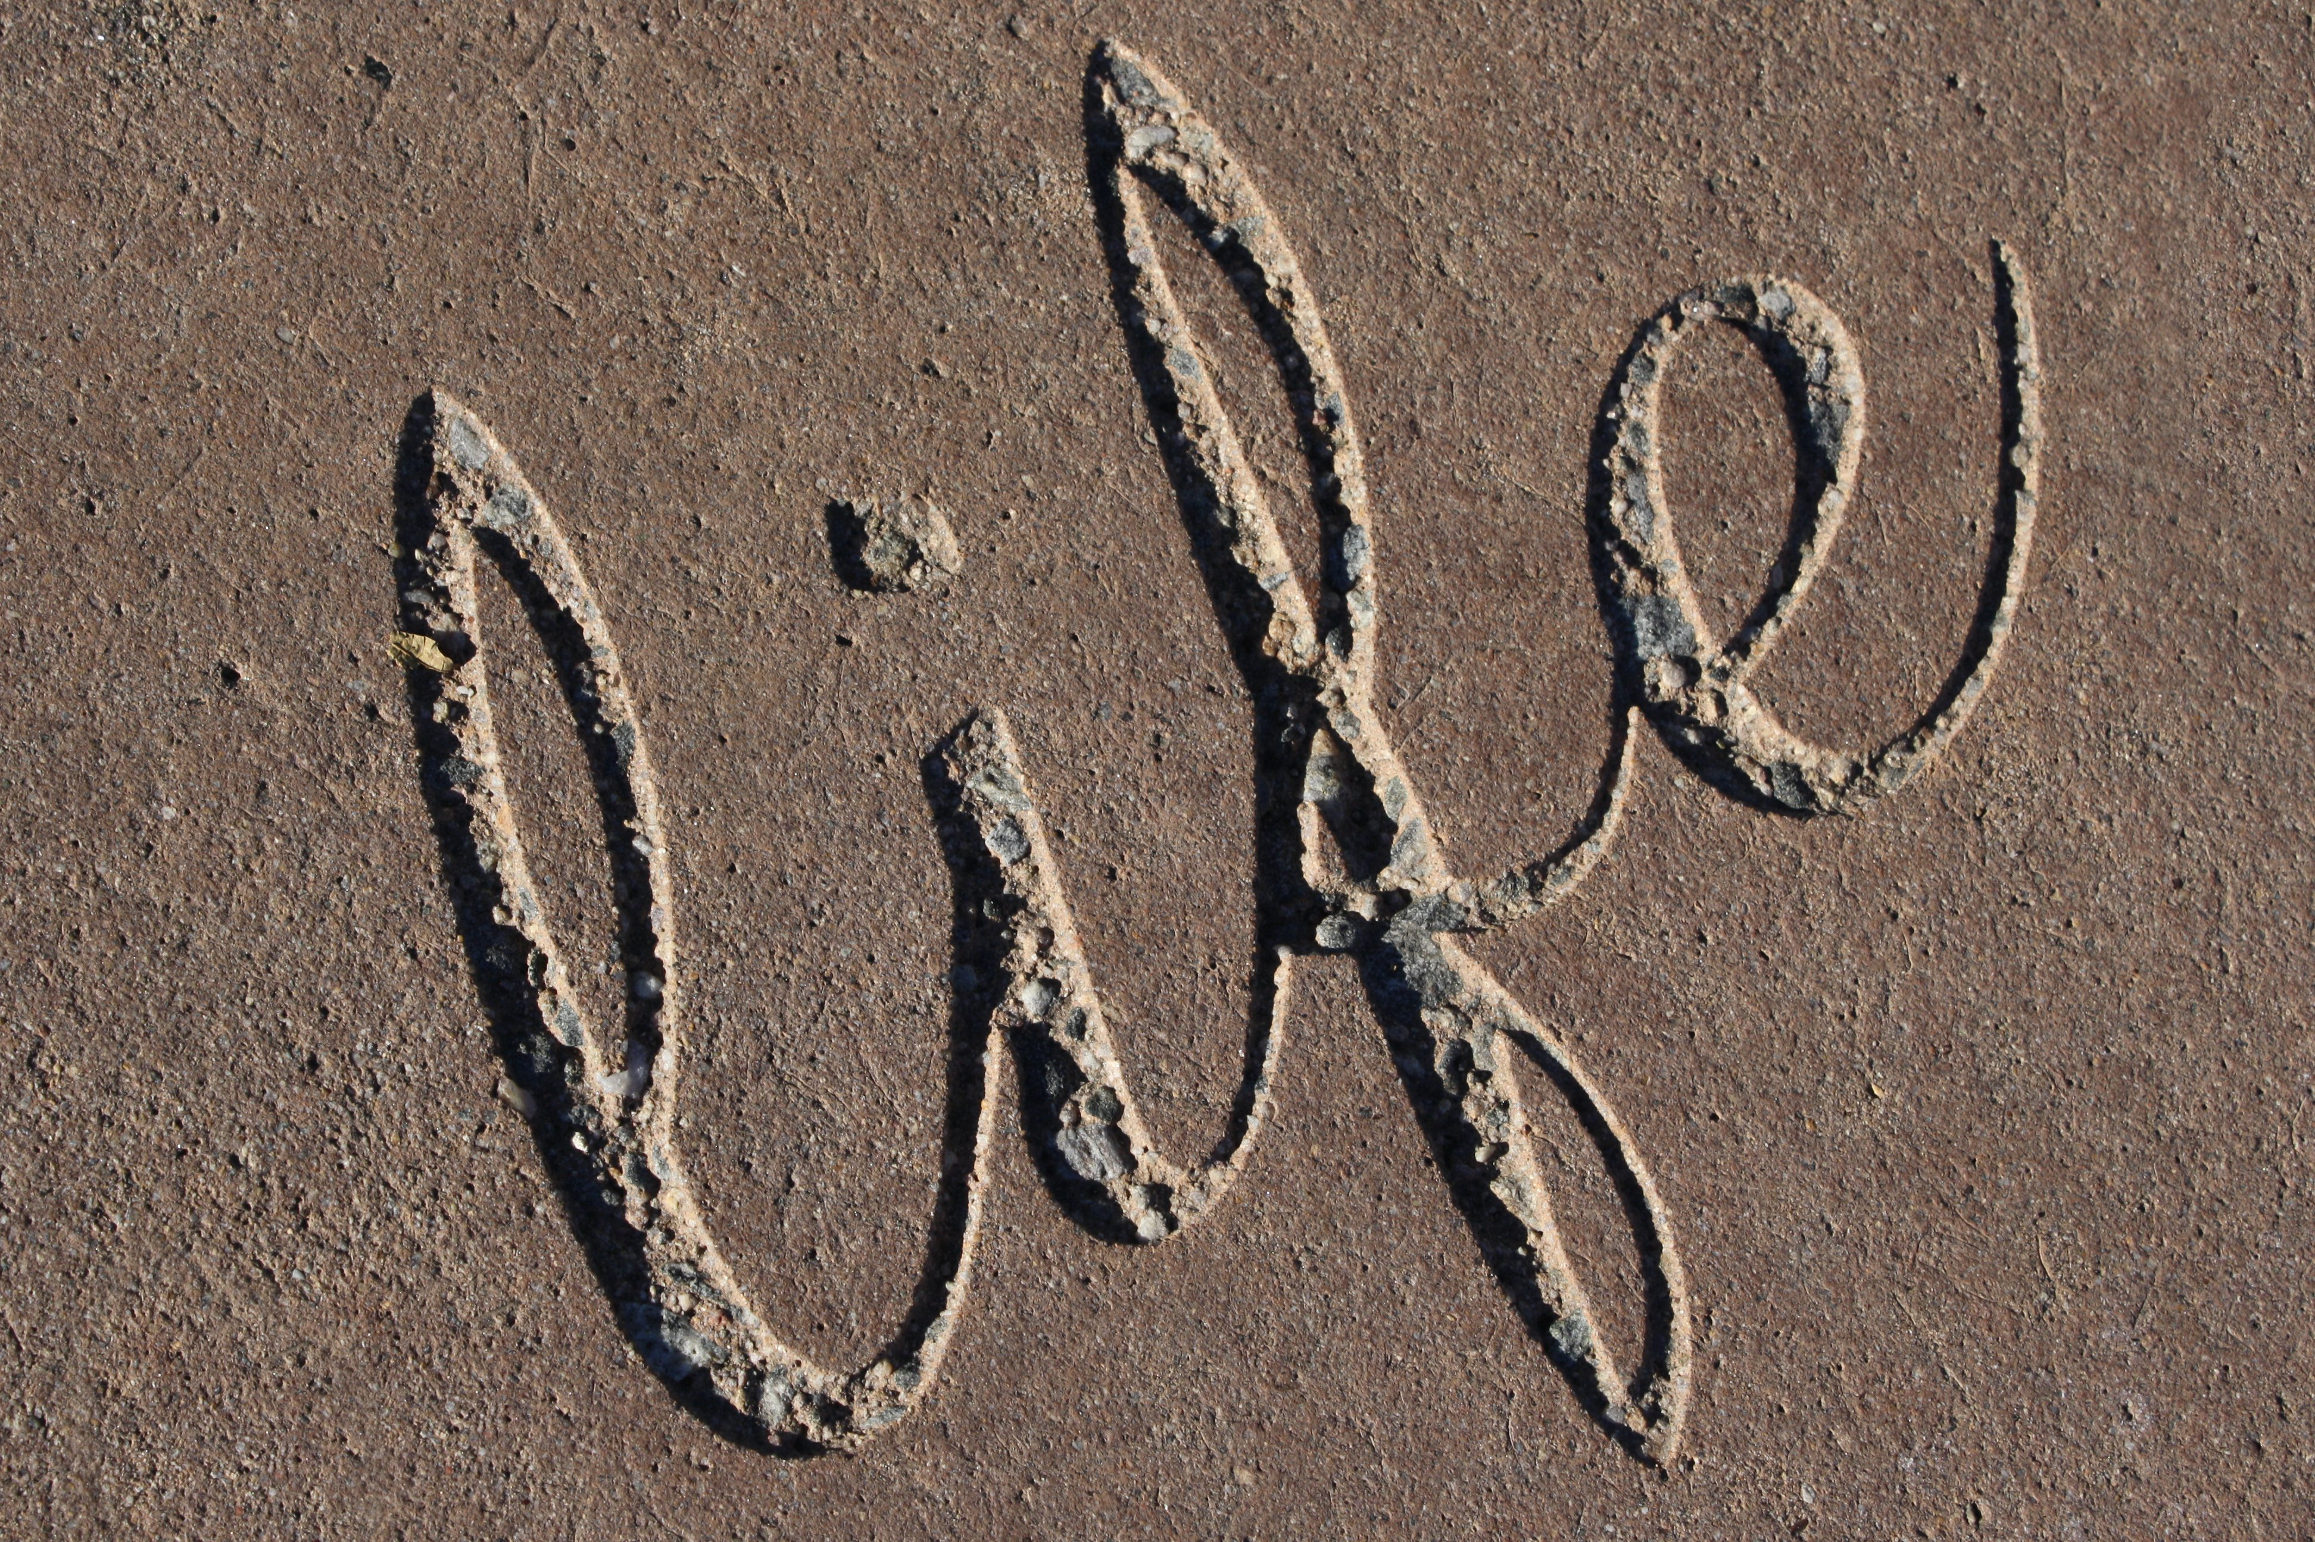
Tell me, what it is you plan to do with your one wild and precious life?
Mary Oliver

Slide 30
Free resources
Multiple intelligence and types: htp://literacyworks.org/mi/assessment/findyourstrengths.html
•45 questions
Inventory of strengths: htp://www.viacharacter.org/VIASurvey/tabid/55/Default.aspx
•120 questions
https://www.fosterpurpose.org/new-page
(Need to start at beginning can not jump to purpose)

Slide 31
Reference
Andrews, L. W. (2017). How a sense of purpose in life improves your health. Psychology Today. Retrieved from psychologytoday.com
Bounce Back project. (n.d.). bouncebackproject.org
Bronk, K. (2017). Cultivating a purpose in life among youth. Retrieved from https://youthspecialties.com/blog/cultivating-purpose-life-among-youth/
Cook-Deegan, P. (2016). Seven ways to help high schoolers find purpose. Retrieved form https://greatergood.berkeley.edu/article/item/seven_ways_to_help_high_schoolers_find_purpose
Fostering purpose project. (n.d.). Retrieved from https://www.fosterpurpose.org/about/
Manson, M. (2014). 7 strange questions that help you find your life's purpose. Retrieved from https://markmanson.net/life-purpose
National Association of County and City Health Officials. (2015). Mobilizing for action through planning and partnerships (MAPP) users handbook. Washington, DC: National Association of County and City Health Officials.
NRSG 820 syllabus. (2018). In C. Sortedahl, & D. Hofmann (Comp.), NRSG 820 DNP seminar and practicum 1 (pp. 1-26). Eau Claire: University of Wisconsin.
Taylor, S. (2016). A model of purpose: From survival to transpersonal purpose. Transpersonal Psychology Review, 18(1). Retrieved from www.bps.org.uk/publications/transpersonal-psychology-review
White, K. W. (2017). Emerging roles for the DNP. In M. E. Zaccagnini & K. W. White (Eds.), The Doctor of Nursing Practice Essentials (3 ed., pp. 375-397). Burlington, MA: Jones & Bartlett Learning.
Whitlock, J. (n.d.). Cultivating a sense of purpose inyouth. . Retrieved from http://www.actforyouth.net/resources/pd/pd14-purpose.pdf
Wright County Community Action. (2018). 2018 Community needs assessment [Brief]. : Wright County Community Action.
Zaccagnini, M. E., & White, K. W. (Eds.). (2017). The doctor of nursing practice essentials: A new model for advanced practice nursing (3 ed.). Burlington, MA: Jones & Bartlett Learning.

Slide 32
Want to Become Part of the Movement?
Text bounceback to: 833-956-0928
Like us on Facebook:
Bounce Back Project
Check out our web pages: www.bouncebackproject.org
Sign up for newsletter: https://bit.ly/3wVS3zo

